Slide 1


A Toolkit Guide to Design for Change
www.socialchange.how
2022 – 2024
Design Thinking for Social Change Learning Centre
Led by Roscommon LEADER Partnership & Le Laba with contributions by all partners

Slide 2
contents
01
Introduction
03
02
Organising a Design for Change Learning Centre
09
03
Building a Learning Centre using Design
Thinking Phases
15
04
Finding and Engaging Members
26
05
Facilitator is Key
37
06
Getting Started
41
07
Sustainability
44
08
Tools and Resources
46
09
Best Practice Case Studies
53
10
Learn More
73

Slide 3
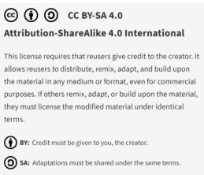
01
Introduction
We are delighted to share this Toolkit as open source under a Creative Commons licence.

Slide 4

Introduction and Background
Design for Change
Design Thinking for Social Change project (Design For Change) aims to train Adult Educators, Social Change Actors, Policy Stakeholders, and other stakeholders involved in social change to use Design Thinking principles as a standard when deciding on priority issues, determining who is affected by community problems and how, determining what solutions are possible and how they affect beneficiaries, developing ideas, and implementing projects.
This method will educate staff, members, and activists in NGOs, development agencies, organisations, and local governments, to address major community concerns, improving the position of community changemakers and civil society to address major community concerns. It will also help make better use of resources and financing, to serve the communities in a human-centric way, when used to solve burning problems and bring positive change.
Main Objective
The main objective of the Design for Change is to develop innovative adult education pathways that will assist social change actors to bring effective, equitable, and long-lasting solutions for positive Social Change, though implementation of the Design Thinking model.
Design Thinking can be used to solve local problems, to gather information from residents on the needs on their estate for example and develop an action plan and activities to solve the issues identified by the community.
Target Group
The target group for this project include adult educators, activists, change ambassadors, social change actors such as, NGOs, social enterprises, development agencies, volunteer centres, community groups and policy stakeholders, grant givers and decision makers in the communities.

Slide 5

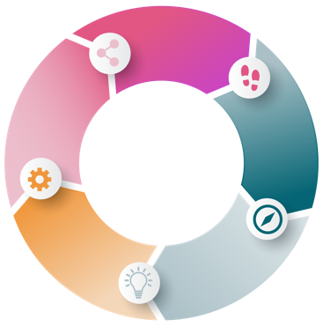
Design Thinking
The Design Thinking approach allows individuals from various backgrounds to work together to solve problems within their community. Setting context and getting a clear understanding of the needs and challenges within the community is imperative when exploring ideas and solutions. Using design tools such prototyping allows all the stakeholders the opportunity to propose and explore concepts that can solve real-world problems.
What is Design Thinking?
Design for Change has added another phase to the Design Thinking Process – the Storytelling phase. Design thinking method of Design for Change takes the community members who are working on bringing positive change, through six iterative non-linear phases. The sixth, storytelling phase is used to present the ideas, solutions and process to the wider community, so that the purpose and aims are given in a friendly, engaging form. Design Thinking is used to understand the lives of people, challenge assumptions, redefine problems and create innovative solutions. Solutions are found through engaging with the six phases.
EMPATHIZE
TEST
learn about the audience
test ideas and gain user feedback
DEFINE
sharpen key questions
build representations
of one or more ideas
PROTOTYPE
IDEATE
brainstorm and create solutions

Slide 6

Empathy
The first phase is Empathy, and this is concerned with understanding the needs of the community and researching these needs.
Definition
The Definition phase is where the needs and the problems faced or experienced by the community is clearly defined and stated.
Ideation
Within the Ideation phase there is scope to challenge assumptions and facilitate creative thinking around the stated problems.
Prototyping
The Prototyping Phase allows the community to being creating solutions and to improve implementation.
Testing
Testing provides the opportunity to try out the solutions, and this may result in moving back to another phase of the process.
Storytelling
Design for Change has added an additional phase Storytelling. At the core of the Design for Change, Storytelling will be incorporated, using stories as a way to understand the final beneficiaries, community members, their problems, everyday lives, using stories to construct the solutions and communicate them to the project target groups

Slide 7


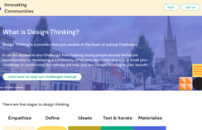
What is a Design for Change Learning Centre?
A Design for Change Learning Centre is a forward-looking local learning focal point, either in person or online, where communities can collectively discuss their needs and find creative and innovative solutions through the use of the design thinking process.
Why have a Learning Centre?
click to type
Design for Change learning centres are local learning environments, which will offer the opportunity to promote social inclusion, civic engagement and democracy, and offer social change makers in the community lifelong and life wide learning opportunities of implementing the Design Thinking methodology in their communities. Through the Design Thinking Learning centres, it is the intention to boost individuals ’social participation and use design thinking methodologies to achieve better outcomes to improve lives in the local community.
Design Thinking has been used widely and successfully across the world, from global companies like Airbnb and Apple to social enterprises and charities.
Huntly is a rural market town in the northeast of Scotland with 5,000 people, a historic town centre and a hinterland predominantly based on agriculture. The town centre had experienced a decade long decline of commercial businesses that once formed the key identity of the town. As a result of design thinking workshops, community members and organisations started to develop people focused ideas and solutions to local problems.
The community gained access to a number of vacant buildings on the town’s main square. After several pop-up events in two of the buildings, they negotiated a six-month rent contract with a former bank branch. This fully serviced building allowed organisations and individuals alike to see the potential that repurposing unused spaces could offer their community.
The success of the pilot led to the community securing funding to purchase the building for long term use.
CLICK TO VIEW
Source: Innovating Communities
Design Thinking | Innovating Communities

Slide 8

Why do we need a toolkit?
The toolkit to establishing a Learning Centre for Social Change is a step-by-step guide intended to guide stakeholders on how to establish, run and sustain a fully functioning centre. It will provide adult educators with a sustainable, participatory model for community solving. The existence of this toolkit provides transferable know-how, for the replication of the method across the EU.
By embedding Design Thinking skills in local learning centres, we enable adults and diverse groups at community level to apply design thinking in tackling issues and problems in their neighbourhoods.

Slide 9
02
Organising a
design for change learning centre

Slide 10
In Person Vs Online Learning Centre
The following checklist will provide guidance on sourcing the most suitable venue for an in person learning centre meeting:
01
Who needs to attend?
05
Is public transport available to the venue?
02
Is it possible to find a central venue?
06
If there is no existing transport links, could you link in with the rural transport provider to establish a service for your group?
03
Is the venue accessible?
04
How long will your meeting last?
07
Are there community car or community bus options available for your members to hire?
08
How often will you meet?
11
Can you avail of free venues from community groups, development agencies, local authorities, Public Participation Networks
09
Will you always use the same central location, or rotate the venue? Will this have transport and childcare considerations?
12
Is it possible to use the kitchen to make tea/coffee?
13
Has the venue space for breakout sessions and small group work?
10
Is there a cost associated with use of the venue? Will you need to charge a membership fee to cover these costs if this is your ideal venue?
14
Is there the potential for onsite childcare facilities?

Slide 11

Planning an in perspn
learning centre
Once you have a list of the different members who should attend, consider where it suits to meet. The local authority or community groups, or local development companies will be happy to help you with a venue, and often this could be free of charge. Consider public transport options and connections that might service your audience, often there would be discounted or free travel for older people and people with disabilities, this may be provided by the state. You could also consider community transport providers who offer reduced rates for the provision of transport.
It is really important to consider the physical accessibility of your venue, this is for people with disabilities and older people with impairments, it will ensure maximum inclusion, community groups and local development companies are also conscious of this need and are likely to have fully accessible offices.
Finally, when planning the agenda, strike a balance between achieving key tasks at meetings, and ensuring to keep the attention of the members, try to limit the duration of your meetings to 90 minutes maximum and build in tea/coffee breaks and time for networking.

Slide 12

Planning an online
learning centre
Things to consider:
Is there good broadband?
Do members have access to IT equipment?
Could you offer a laptop/ tablet loan scheme to those from socially vulnerable backgrounds without the necessary devices to engage?
Are members digitally literate and familiar with online platforms such as zoom, MS Teams?
The duration of the meeting, participants attending online meetings tend to have less of an attention span, set a realistic amount time for the online meeting, keep it focused and use interactive tools where possible.
Engagement techniques are different for online meetings, ensure adequate breaks, use of breakout rooms and a variety of engagement methodologies to ensure maximum participation by attendees
Which online platform is most suited to your meeting?
When organising an online meeting you may want to consider the following platforms and chose the one that suits your members best

Slide 13

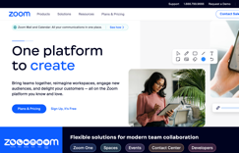



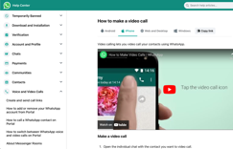
For More Information on Zoom
Zoom is an online video meeting tool which adult educators and communities can use to host online meetings. Zoom gives educators and community members plenty of tools to interact with each other and even has the functionality to enable break out into smaller groups – just as if they were sitting with each other in a room.
CLICK TO VIEW
For More Information on MS Teams
Microsoft Teams is a collaboration app to allow everyone participate in sessions as if they are all in the one place.
The functions include:
Chat- Message someone or a group
Teams- Create a team and channels to gather people together and work in focused spaces with conversations and files.
CLICK TO VIEW
For More Information on WhatsApp
WhatsApp – Is a mobile app. An advantage of WhatsApp is its widespread use via mobile phones. Most people are familiar with the platform, which means little training time is required. It is also accessible via a computer and can therefore be useful for sending and saving files. The group chat feature can also be used for knowledge sharing, which can increase productivity.
CLICK TO VIEW

Slide 14


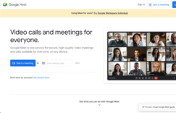

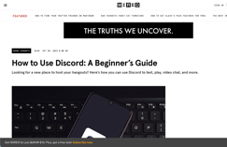
Google Meet is a multi-person video conferencing application. Adult educators and communities can use is to communicate to groups.
For More Information on Google Meet
CLICK TO VIEW
For More Information on Discord
“Kahoots” are multiple-choice quizzes that can be accessed via a web browser or the Kahoot app. Kahoot! can be used to review learners’ knowledge for formative assessment or as a break from traditional classroom activities.
Discord can be used for texting, voice calls, or video calls.
You can participate in Discord’s text, voice, or video chats on mobile devices or desktop computers.
CLICK TO VIEW
Online Meetings will require good IT infrastructure and access to IT equipment for those you wish to engage.

Slide 15
03
Building a learning centre using design thinking phases

Slide 16



Remember the phases of Design Thinking in the Design for Change Project include
Empathy
Definition
Ideation
Prototyping
Testing
Storytelling
Empathy
See Their World
Appreciate Them as
Human Beings
Empathy
Understand Their Feelings
Communicate Your Understandings
When initiating a Learning Centre, it is essential to start by putting your own expertise and agenda aside and thinking about the people who will be part of the centre. Begin with developing empathy for your members, and consider
Who is going to be in the room and what are their needs?
In what broader culture and environment are you operating and what are some of the overarching challenges and opportunities?

Slide 17

Actively seek out individuals who will attend the first meeting, or who will be interested in the development of the Learning Centre, in Design thinking and the processes and who will help progress developments and speak with them — ideally in person. Even if you run regular meetings with the same group of people, these individual brief check-ins can help build trust, identify any issues and ensures that participants feel more invested. In order to practice empathy, it is important to be non-judgemental, be open to the opinions and perspectives of others, and be an active listener, focus on what is being said and respond thoughtfully understanding the emotions of those involved.
Key personnel:
Facilitator and stakeholders, target groups, for example Adult Educators, Activist, Change Ambassadors, Community Group Representatives, NGOs, Social Enterprises, Development Agencies, Volunteer Centres, Policy and Decision makers, Migrants and Refugees, Youth, Women and Older People.
When we refer to target groups these are the individuals, the members, users or participants of the centre.
Duration:
1 month to identify and meet key stakeholders. It is recommended that there are in the region of 40 consistent members for each centre. New members are welcome to join when the group takes on a new problem to solve. Ongoing check-ins with participants throughout the lifecycle of the learning centre is recommended.
Tools that can be used during the Empathy Phase:
In this phase consider the needs of the community. A brainstorm analysis could be undertaken, in which participants of the learning centre come up with different ideas that could bring an impact to the community: Such as improving the accessibility of an Urban garden, improve and accessibility of areas for people with disabilities as an example.
During this phase it is important to establish short-term and long-term goals for the centre.
The group should ¨Map the area¨ identifying different actors that could be involved in the problem (local activists, public workers, city councils, local authorities etc.)
The Scholar Teresa Wiseman established the 4 principles for empathizing.¹
¹Empathy builds connection. University of Kentucky:
https://powell.ca.uky.edu/files/empathybuildsconnection.pdf

Slide 18
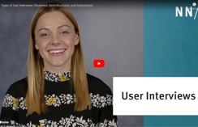
01
Taking on someone else’s perspective. When you share or take on the perspective of another person, you must also be able to recognize someone else’s perspective as truth.
Being non-judgmental. When we judge another person’s situation, we discount their experience. Therefore, to take on the perspective of another person, you must put away your own thoughts, assumptions, and biases.
Recognizing someone else’s emotion or understanding their feelings. Recognizing and understanding someone else’s emotions requires you to be in touch with your own feelings and to put yourself aside so that you can focus on the person in distress.
Communicating your understanding of a person’s feelings. It is important to not only express your understanding of someone’s emotions or feelings but to also validate them. Validating someone’s feelings demonstrates that you accept, acknowledge, and understand them.
02
03
04
It is very important that consideration is given to the opinions of others and their experiences is fundamental to the empathy phase of design thinking. In order to establish the participants, the needs and issues faced by others you could consider conducting interviews. The following video is a useful guide on how to structure different type of interviews.
The next task involves creating a user interview template to help you structure the information, prepare notes, and gathered information from your interview´s respondents.
The steps for creating a User Interview are:
CLICK TO VIEW
01
Present yourself and present the purpose of the interview. Ask the respondents if allows you to record the interview.
02
Create a sharing space and enable the user to communicate as much as possible. Ask open-ended questions for obtain descriptive answers such as:
Do you know this product? Why did you choose it? The open-ended questions should be linked with the topic you are trying to address.
03
Use the most appropiate language and assure the respondent understand the questions asked.

Slide 19
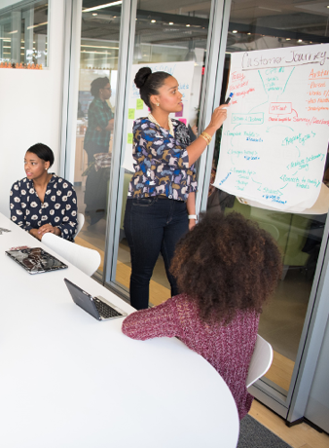
Task 2. The next task will be to identify the challenges your users might be facing.
For doing so:
Identify who your users are (minimum 3)
Interview your users and keep notes.
Record (if possible) video and audio, to work later on the materials gathered. If the material is recorded it will allow you to come back as many times as possible to work on the insights.
Based on the information obtained, structure the information and select some ideas for your design challenge; What are you trying to accomplish?
Source: Drambyls; Design Thinking Embrace
Definition
Once the members Define what the centre will aim to achieve, next it needs to establish what problems, issues, challenges will it address. Next, set a frame for developing the centre. Include the desired outcomes so that participants know why they’re participating. Design thinking encourages measurement of results. When you conduct surveys, ask for feedback from the attendees and hold focus groups, this leads to a mindset of constant growth and betterment.
Key personnel:
Facilitator and stakeholders, target groups, for example Adult Educators, Activist, Change Ambassadors, Community Group Representatives, NGOs, Social Enterprises, Development Agencies, Volunteer Centres, Policy and Decision makers, Migrants and Refugees, Youth, Women and Older People.
Duration: 1-2 months
Tools that can be used during the Definition Phase:
It is important to build a strong sense of team at this stage and engage in teambuilding activities and icebreakers to build the effectiveness of the members to work collectively to define the problem.
The use of SMART (Specific, Measurable, Achievable, Realistic and Timed) will help with definition of the problem.

Slide 20
It will be helpful to have pens, pencils, paper, sticky notes, flipchart paper and markers to facilitate this phase.
To analyse the information sourced during this phase you could develop a “User needs statements”.
A user need statement is an actionable problem statement used to summarize who a particular user is, the user’s need, and why the need is important to that user. It defines what you want to solve before you move on to generating potential solutions.
(Sarah Gibbons, User Need Statements: The ‘Define’ Stage in Design Thinking, 2019).
Ideation
Now that you have identified what problem the Learning Centre is planning to address the next step is to Ideate, to creatively design to find solutions. You can use an array of mix methods to work with the members to develop creative solutions to the problem or issue they want to solve. This is the phase where we encourage people to be playful, to put reality on hold for a bit and push past their initial, “go-to” ideas. You could consider the use of film, images, poetry, or music to spark ideas. To create an opportunity for personal sharing and connection. While this might sound frivolous, it is extremely important. This is not only an opportunity to simply get a task complete but are also foster a positive culture amongst the members of the centre.
Key personnel:
Facilitator and stakeholders, target groups, for example Adult Educators, Activist, Change Ambassadors, Community Group Representatives, NGOs, Social Enterprises, Development Agencies, Volunteer Centres, Policy and Decision makers, Migrants and Refugees, Youth, Women and Older People.
You may want to engage individuals/tutors from a creative background to help lead the session depending on the topic
Duration: 4- 6 weeks
Tools that can be used during the Ideation Phase:
In order to generate creative ideas that are agreeable by all the members it is useful to consider using one or more of the following methods.
Brainstorming: Within the groups, this technique allows to generate as many ideas as possible.
Set a time: Participants should be aware that they have a time limit to complete the task.
Start from your target group: Based on the user personas. What are the problems they are facing?
Have an open mindset: encourage participants to bring ideas even if they are ¨wacky¨.
Facilitate the visual ideation: By adding post it into a white board or other elements where the ideas are registered.
Construct others’ ideas: Some ideas might be similar and sometimes can be further developed, complementing the idea proposed.

Slide 21

Brainwriting: Similar to the previous one, with the particularity that participants write their ideas on paper, and after, they pass on their own piece paper to another. This technique helps the participants who might feel shy or inhibited.
Brainwalking: Participants write a single idea on a post-it, which is placed on a wall or white board. Ideas are refined further to the most popular concepts amongst those on the wall.
Braindump: The technique is like brainwriting; however, participants write their ideas first individually and then share it with the team.
Creative pauses: While feeling stuck with ideas, creative pauses are necessary to bring further perspectives into the design process. Sometimes, ideas do not come with justification enough to go ahead with the testing phase. Nevertheless, it is important to remember that Design Thinking is not a linear process and after the testing session some of the ideas drafted can emerge for further implementation.
Source: Drambyls; Design Thinking Embrace
Prototyping
Once you have identified a potential solution(s) identify how you might develop a prototype. A prototype allows communities to quickly propose and explore concepts that can help solve real problems within communities. Prototyping can use the concept of journey mapping and can take the form of a campaign. Prototyping should take a front seat in the early stages of the centre development, is this solution possible, is it workable, what amendments or adjustments might be needed. This way you can assess viability from the beginning.
Key personnel:
Facilitator and stakeholders, target groups, for example Adult Educators, Activist, Change Ambassadors, Community Group Representatives, NGOs, Social Enterprises, Development Agencies, Volunteer Centres, Policy and Decision makers, Migrants and Refugees, Youth, Women and Older People.
You may want to engage design specialists, graphic designers, or experts depending on the topic you are developing a prototype for
Duration: 1-2 months

Slide 22
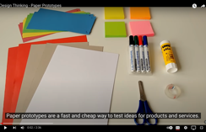

More information on Paper Prototypes can be found in this video
CLICK TO VIEW
Tools that can be used during
the Prototyping Phase:
Prototypes can be divided into different categories, from those that do not require significant time to develop, and are termed low fidelity prototypes, these can include sketches and paper prototypes. The other end of prototypes is known as high fidelity prototypes which are more advanced in terms of details and take longer to develop.
Testing
Next, test-drive your plan, in the same way that a product designer would put an early prototype into users’ hands. In this context, this might be a draft agenda shared with participants. Their responses will help you gain more empathy, frame new questions, get even more creative in your centre and meeting design, and increase your potential for success. This means that the prototype you have created, will go back into the "fixing stage", when you will implement to collected feedback from your users and improve it.
Key personnel:
Facilitator and stakeholders, target groups, for example Adult Educators, Activist, Change Ambassadors, Community Group Representatives, NGOs, Social Enterprises, Development Agencies, Volunteer Centres, Policy and Decision makers, Migrants and Refugees, Youth, Women and Older People.
Duration: 2-4 weeks
Steps to be used during the Testing Phase:
The following graphics illustrate the different steps to be taken during the testing phase.

Slide 23
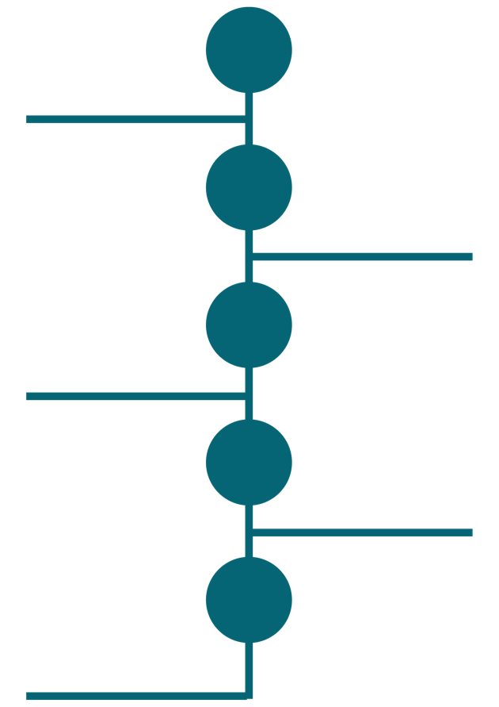

Testing Stage
STEP
O1
Objectives
What do you want to figure out?
STEP
O2
Method
Which methods applies better to your purpose, considering the time and budget allocated?
Participants
STEP
O3
Who will take part in the testing? How you will recuit them?
STEP
O4
Data & Analysis
Which data you will collect? How you will analyse it?
STEP
O5
The location
Where the testing will take place? Do you plan to carry out presential or online?

Slide 24
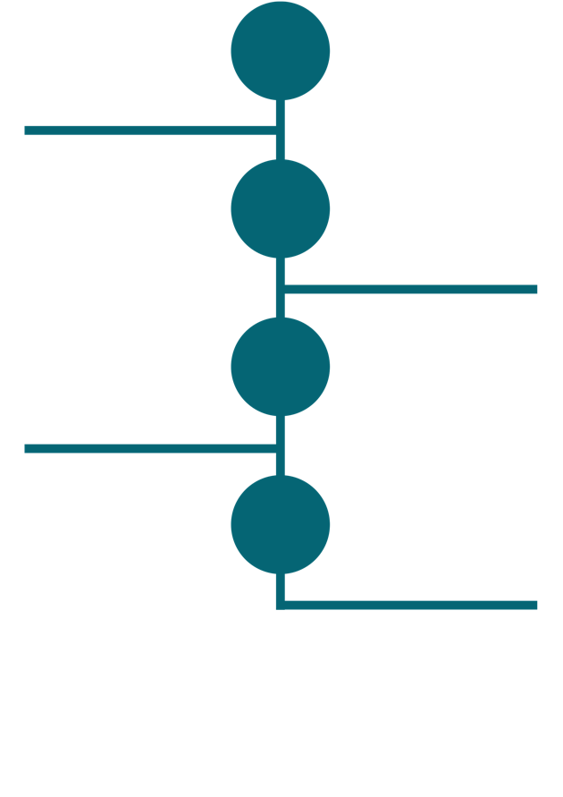

Testing Stage
Script
STEP
O6
Brief introduction about your research purposes and interview guide
STEP
O7
Consent
Inform the participants the purpose of your research
STEP
O8
Communication
Communicate with your team your findings
STEP
O9
Time plan
Schedule the time for the research and when it will be accomplished

Slide 25

Storytelling
Now when you have created the solution needed for social change, it is time to make it known and share it. Storytelling can be used for efficiently communicating what you have done to the users and wider community. You should not underestimate the use of the power of storytelling to motivate change. Storytelling is a useful tool in design thinking, to add personal context and bring a human element into the process. Stories embed feelings and connection into a project by appealing to the listeners values. This connects wonderfully with the empathy phase at the beginning of the process and let’s you show the public that your learning centre has created these solutions with empathy. Each phase has its benefits. It helps people feel included, valued and gives them a sense that they themselves have the resources to affect social change using Design Thinking. In turn they become more invested in the process, in finding the solution and overall, in the development of the Learning Centre.
Key personnel:
Facilitator and stakeholders, target groups, for example Adult Educators, Activist, Change Ambassadors, Community Group Representatives, NGOs, Social Enterprises, Development Agencies, Volunteer Centres, Policy and Decision makers, Migrants and Refugees, Youth, Women and Older People.
You may want to include an experienced storyteller to help frame and tell the overall story. It is also important to consider building relationships with local media who can help tell the story of your project, and don’t forget the power and reach of your own social media.
Duration: 1-2 weeks
Tools that could be used in the Storytelling Phase:
Promotion Plans to tell the story. For this you need to identify who the audience is that you want to reach, how you will reach them, what platforms you will use, both traditional and social media platforms, when is best to advertise your story and what the cost will be.
Social media strategy to reach audiences
A strategy will help the Learning Centre plan where it is going. The centre should begin by consider the following questions in order to inform their strategy.
Why should the Learning Centre have a social media presence?
Who is the target audience of the Centre?
What will the Centre share on social media?
Where will the Centre share content, on what platforms?
When will the Centre share what on social media?
Once the centre has answered these questions it will be clear on how it will use the Social Media strategy to promote the story of the centre.

Slide 26
04
Finding and engaging
members

Slide 27

Finding Your Members/ Stakeholds And Engaging Them
Who needs to be involved?
Having representation and balance across the different sectors is essential to achieve a Learning Centre with a solid foundation. The Learning Centre should reflect all sectors and their different forms. Ideally, the Learning Centre should consist of approximately 40 members including representatives of adult educators, development agencies, community representatives, policy makers, with a specific focus on migrant and refugee communities, women, youth and older people, governments, community.
It is suggested to prepare a comprehensive list of potential representatives from the following list of organisations, listing their names, contact information and role:
The groups who we are hoping to engage in the Design for Change project include:
06
Social Enterprises
01
Adult educators
07
Development Agencies
02
Activists
08
Volunteer Centres
03
Change ambassadors
09
Policy Stakeholders
04
Community Group Representatives
10
Grant givers
05
NGOs
11
Decision makers in the communities

Slide 28

Our communities are diverse with a broad range of skills, abilities, backgrounds and experiences. It is critically important that we ensure inclusive representation in centres and promote active citizenship. This project believes there needs to be a particular focus on:
1
Migrants and refugees
2
Youth
3
Women
4
Older People

Slide 29


Methodologies for Engagement
Contacting Representatives /
Groups
Before contacting groups and organisations prepare a document on the Learning Centre and the Design for Change Project, outline the role of the centre, provide information on Design Thinking and also provide details of expected commitment, details on location, duration and timeframe for Learning Centre Meetings. Provide some compelling reasons why these groups and organisations may want to be involved.
In order to engage members, reach out to existing groups in your area, use local notes in papers, newsletters, community radio, place an advert in local networking groups such as the Public Participation Networks, reach out to Development Companies ask them to share the information amongst their groups.
A Template of Invitation Letter inviting people to join can be found in the Tools and Resources section.

Slide 30

Use of social media to promote engagement
Over 49% of the world’s population uses some form of social media. Publish content to all social media. Social media is the new marketplace, so make maximus use of the various channels to deliver your message via the social platforms on which your target audience is already spending time. We know many young people use snapchat and TikTok to gain information on activities and events, use the relevant channel based on the demographics you want to reach.
Promote the development of the Learning Centres on the Design for Change project social media channels, encouraging target groups to reach out to the project. Encourage all stakeholder organisations involved in the project to highlight the development of the Learning Centres through their own channels, including social media and digital marketing.

Slide 31

Tips to maximise use of social media
Dedicate specific time each week to create and scheduling content,
Ensure you set your target audience in preferences to target specific areas and age groups
Use analytics to decipher if your posts are engaging the intended audience
Reach out to already established organisations or groups and ask them to share your content
Don’t forget to use storytelling and images where consent has been secured to help promote your messages.
Ask other organisations that you are connected with to share your content on their platforms
The following is peak times for posting based on research by HubSpot:
Marketers suggest the Peak Times to post on Instagram is Saturdays 6 to 9pm
Marketers suggest the Peak Times to post on Facebook is Saturdays 6 to 9pm
Marketers suggest the Peak Times to post on Twitter is Friday 6 to 9pm
Marketers suggest the Peak Times to post on LinkedIn is Saturday, Sundays and Wednesdays 6 to 9pm
Marketers suggest the Peak Times to post on TikTok Saturday, Sunday and Thursdays 3-6pm and 6-9pm²
Focused and mixed methods of engagement may be necessary for online meetings, the following may be useful tools.
² https://blog.hubspot.com/marketing/best-times-post-pin-tweet-social-media-infographic#:~:text=However%2C%20the%20data%20suggests%20that,then%20noon%20to%203%20p.m.

Slide 32


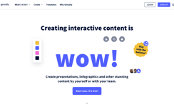

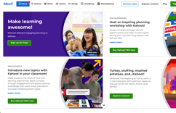
Genially is an interactive visual communication tool which educators and adult learners can use to create presentations, interactive images, infographics, quizzes and more.
For More Information on Genially
CLICK TO VIEW
For More Information on Kahoot
“Kahoots” are multiple-choice quizzes that can be accessed via a web browser or the Kahoot app. Kahoot! can be used to review learners’ knowledge for formative assessment or as a break from traditional classroom activities.
“Kahoots” are multiple-choice quizzes that can be accessed via a web browser or the Kahoot app. Kahoot! can be used to review learners’ knowledge for formative assessment or as a break from traditional classroom activities.
CLICK TO VIEW

Slide 33



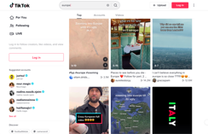
Nearpod helps educators make any lesson interactive whether in the classroom or virtual. The concept is simple. A teacher can create interactive presentations that can contain Quiz’s, Polls, Videos, Collaborate Boards, and more.
For More Information on Nearpod
CLICK TO VIEW
For More Information on TikTok
“Kahoots” are multiple-choice quizzes that can be accessed via a web browser or the Kahoot app. Kahoot! can be used to review learners’ knowledge for formative assessment or as a break from traditional classroom activities.
TikTok is a popular social network which adult educators can use to create short educational videos on particular topics. #LearnOnTikTok features a range of educational videos which were created in order to help facilitate learning during the COVID-19 lockdowns. Average users, most of them aged between14-30 spend about 52 minutes per day on TikTok, making it a great tool to potentially reach younger adult learners.
CLICK TO VIEW

Slide 34

How to achieve engagement from Migrants and Ukrainian and other refugees.
A specific plan should be developed to encourage and support Migrants and Ukrainian Refugees to engage.
Steps to engage Migrants and Refugees:
Firstly, you may want to translate the information document on the learning centres into specific languages to ensure a thorough understanding on the part of the Migrants and Refugees including Ukrainian Refugees.
In order to engage Migrants and Refugees it may be necessary to work with development agencies or support groups in order to reach the target group.
Make an appointment to meet the group and explain in plain language the aim of the project and the role of the centre, provide information on Design Thinking and also provide details of expected commitment, details on location, duration and timeframe for Learning Centre Meetings. Be enthusiastic and encouraging and take and respond appropriately to any questions posed.
Offer support to the Migrant and Refugees representatives to ensure they feel capable of participation and confident to represent their community group.
Work with the representatives to identify a potential barriers to participation and engagement with the centre, such as childcare, language, transport and work collectively to try and overcome these challenges including if necessary, having an Interpreter for meetings, or offering hybrid engagement if childcare/eldercare or transport is a barrier.
In advance of the meetings, meet with these representatives to discuss the agenda and build their capacity to participate.
01
02
03
04
05
06
In advance of the meetings, meet with these representatives to discuss the agenda and build their capacity to participate.
06

Slide 35
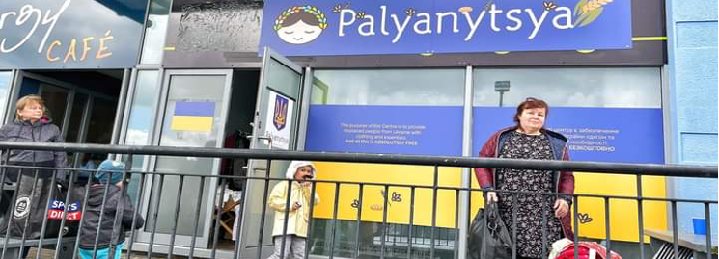
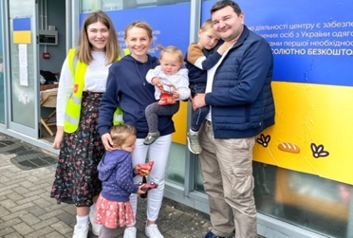
Palyanytsya: Take What You Need…
An Example of Engagement of Ukrainian Refugees from Leitrim, Ireland
The initiator of these hubs was himself from the Ukraine. He set out to establish the needs of the refugees fleeing the war, using the design thinking concept of empathy he established the immediate needs of the Ukrainian Refugees. Through consultation with Ukrainian refugees immediate needs of clothes, toiletries and equipment for children were identified as the initial primary needs. Thereafter the issues presenting on arrival were defined and hubs were opened as a response to issues identified.
The establishment of hubs were an innovative way of meeting needs, however, they in themselves presented as a way for the needs of those availing of the service to be further identified.
A ray of hope for refugees arriving in Ireland are the shops Palyanytsya. The shops were started by businessman Ruslan Mocharsky the founder of Art of Coffee in Dublin, originally from Ukraine. When the war in Ukraine began, he wanted to do what he could to help. He used the design thinking concept of empathy to establish what the immediate needs of the Ukrainian Refugees were, and he set about trying to meet these needs. From the outset it was clear that there was an urgent need for basic supplies such as toiletries, clothes and equipment for babies and toys for children.
Ruslan asked for help from the organisation “Ukrainians in Ireland” and his business network. A hub in Carrick on Shannon was opened through the help of Ivan and Diana Tarkovich living in Leitrim. They saw the hub as an innovative way to help refugees arriving from Ukraine, again this model built on the concept of empathy, where they could reach out to those in need who were presenting to the shop and further establish what their needs and concerns were. Through word of mouth, volunteers helped set up the shop and later run it. The local paper and social media helped in recruiting the many helping hands necessary to keep going over the months.

Slide 36
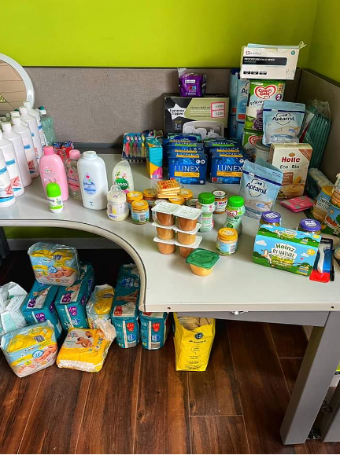
The mission of the shops is to be a free source of essential items for displaced Ukrainians. They want to make sure individuals or families have their basic needs met as soon as they arrive in Ireland. Even the space used for the shop is free and donated for this purpose.
Overall, Palynytsya has helped in meeting the essential needs of new arrivals each week in Leitrim. Connections have been made between locals and the Ukrainian refugees in the community. Local businesses have reached out to support the hub and given funding or donated items. Refugees who have received the help have gone on to volunteer at the shop or other community organisations.

Slide 37
05
Facilitator is
Key

Slide 38

Guidelines for a good facilitator
The facilitator is responsible for managing meetings, keeping conversations on track, and ensuring each member’s voice is heard. A good facilitator will manage the flow of the discussion. The facilitator guides the dialogue and endeavours to ensure maximum input from participants and keep them on track.
By recognising the unique and valuable contributions of each member, an effective facilitator increases the collective value of the entire community.
Characteristics of a
Good Facilitator
01
Good facilitators value people, their opinions and ideas
A good facilitator will manage the flow of the discussion.
02
Good facilitators think quickly and logically
03
Good facilitators are excellent communicators
04
Good facilitators are concerned with both product and process

Slide 39

What is the role of the facilitator?
Prepare in Advance.
Good facilitators make their work look effortless and natural but prepare in advance to be effective. Take into consideration the “who, what, why, and where” of your meeting to help you figure out the “how.”
Plan and Distribute the Agenda.
The meeting agenda is the document that defines what will be done at the meeting, it is vital the facilitator plans the agenda carefully in advance of the meeting.
State your objectives at the beginning of the event.
Members will be much better prepared to contribute and help you meet the objectives if they know what they are. The job of a facilitator is to ensure that the group understands what needs to be accomplished by the end of the meeting.
Establish Community Expectations.
Identify the expected outcomes and work with members to develop ground rules, which will support participants to establish appropriate ways to interact with each other during the meeting.
Staying on-task and on-time.
Your community may have a lot to get accomplished in a short amount of time. With groups of passionate and knowledgeable people, it is easy to veer off onto other topics or easily get side-tracked by minute details of a conversation. In order to help the group, stay focused, you may want to:
Remind the group to “keep focused”
Don’t be afraid to directly re-focus the group
Try to close the item or set it aside in a “parking lot” for consideration later
Let the community decide
Dealing with unproductive behaviour.
Difficult behaviour is often unintentional or occurs as the result of an emotionally charged situation. You might be dealing with inattentive members who are engaging in side-bar conversations, taking calls or indiscreetly dealing with e-mail. You might also be dealing with personal agendas or disrespectful behaviour. In order to focus the entire group, you may wish to
Use gentle and appropriate humour for redirection
Restate the ground rules
Direct your questions to the individual for clarification

Slide 40

Checklist for an effective facilitator
An effective facilitator should:
Focus on the group’s agenda. A great facilitator never sways the outcome by sharing their preferences or perspectives.
Be responsive to group dynamics through the entire process. Pay attention to things like:
Who’s speaking and for how long
Who’s not speaking
Body language
Inflection and tone of voice
Reactions from group members
Personal agendas (as opposed to the group agenda)
Judgmental comments, or feedback that is given unskilfully
Intentionally work to include the voices of all the members of the group, offering opportunities and/or different structures to support quieter, thoughtful, or dissenting voices to participate
Help everyone uphold all group agreements, checking in with the group to offer and support the addition of new norms when needed to improve group dynamics.
Change the agenda if necessary to meet the group’s needs, keeping focused on the purpose and goals of the group, and the work at hand.
Know what to do when problems inevitably arise. Have a plan B!
Resist taking matters personally. Groups or individuals sometimes vent their frustration, anger and fears on the facilitators. A good facilitator always remains neutral.
Work for balance between process and content. Honour meeting and break times.
Celebrate group successes!
Keep a sense of humour! Developing a light, humorous tone (when appropriate) can go a long way when facilitating a meeting.

Slide 41
06
Getting
Started

Slide 42

The first meeting
It is really important to set the scene at the first meeting, for the venue to be warm and welcoming, be that online or in person. It is also critical where possible to honour timings and to give some time to networking and relationship building – use of the breakout rooms is a great feature for this for online.
Begin with an icebreaker to settle everyone in and help develop relationships.
Provide a good introduction to the topic of Design Thinking and also to the Design for Change project and its scope and check for understanding.
Identify if there are any gaps in membership, and who else should be invited to attend.
Agree on how the members will communicate with each other outside of meetings.
Agree on initial roles for the Learning Centre, Chairperson, secretary and the role and responsibility of the facilitator.
Agree timeframe for sending out minutes and notification of meetings.
Do you want to launch the Centre, how, when, where?
Compile a robust contact list.
Secure appropriate consents for data collection, and taking and using of photos in line with EUGDPR.
The Agenda
Notifications and agendas should be circulated at least one week in advance of the first and subsequent meetings.
Meeting notifications should include
The venue
The Platform, link and password if is online
The time of the meeting
The expected duration of the meeting
The proposed agenda
Any related documents for reading
Instructions on any preparatory work required ahead of the meeting
A sample is provided in the Tools and Resources Section.

Slide 43

Post meeting
You want to continue to promote the formation of the Learning Centre online so take photos with appropriate consents from those in the photographs. Is there someone in the group who might help write a press release for local media and websites?
Using Design Thinking in your meeting
Remember, the key ingredients of design thinking to apply to meetings are empathising with participants to make sure all their needs are being considered and met; use creative tools to all for the innovative ideas to emerge, those that can be visualised at meetings, have a wide range of skillsets amongst the members to get different perspectives on finding solutions, and the development of prototypes.

Slide 44
07
Sustainability

Slide 45

SUSTAINABILITY OF LEARNING CENTRE
Sustainability Considerations
The Learning Centre will act as a catalyst for change and a learning hub to promote and advocate the use of Design Thinking processes to affect social change. It is important that the Learning Centre thinks about and plans for sustainability from its inception as opposed to when your project is nearing completion. It is recommended to consider a progress a sustainability plan at least the second meeting of the centre. It can also be useful to form a subgroup or committee to work specifically on this issue. This subgroup can make recommendations to the Learning Centre for further consideration. It is important for stakeholders to consider what is really necessary to support the continuation of the Learning Centre and how new commitments can be elicited.
Building upon and enhancing established activities can be a firm basis for added value progress
Work to create a strong Learning Centre group (stable, goal-focused and strong engagement through all members)
Initiate achievable projects that are aligned with the priorities and also help other organisations fulfil their mission
Sustainability is enhanced when the Learning Centre engages in public relations from the outset to keep the activities/issues highly visible
Obtain enough resources to generate an initial success through grants from local development companies, use of free venues and support with facilitation and then try to secure more long-term funding for new projects that are based on a demonstrated need in the community. Harness cross-sector support as opposed to a single funder approach
Where possible maintain continuity in Learning Centre members
Build alliances with other groups that have a similar mission
Have a separate group/committee focused on sustainability so that others can focus on the Learning Centre’s desired outcomes
Explore alternative approaches for sustainability, be flexible
Build in an evaluation of the Learning Centre throughout the life cycle of the project
Tips to ensure sustainability

Slide 46
08
Tools and Resources

Slide 47

A charter is a statement of intent and represents the collective ambition of your Learning Centre. It is not a legal document, it is non-formal, but operates as a motivational tool to engage members in a collective process based on the goals of the project. It sets out expectations and responsibilities of the members of the Learning Centre. The charter is signed by each member of the Learning Centre on joining the centre.
Sample Charter
As a member of the Design For Change Learning Centre of the _______ community, I am committed to attending meetings, disseminating information and supporting the goals of the project.
I am aware that the main objective of Design for Change is to develop innovative adult education pathways that will assist social change actors to bring effective, equitable, and long-lasting solutions for positive Social Change, though implementation of the Design Thinking model.
I will at all times act with respect for the other members of the Learning Centre and respect the principles of diversity and equality.
I will work together in a spirit of positive and constructive debate.
I will inform Learning Centre members of any potential conflict of interest and withdraw from discussions if necessary.
I will support the principle of open and honest communication in order to allow the widest possible access and participation in the work of the Learning Centre.
In addition to committing my time, I will use other sources of information as appropriate, and point members to useful connections and resources.
Name:
Date:
Organisation:
(Please indicate if you are an individual member)
E-mail address / preferred form of communication:

Slide 48
Sample Agenda
SAMPLE AGENDA
Roscommon Learning Centre
Location: | The Cube Flexi Space, Landsborough Road, Roscommon Town F42 DX61
Date: | October 3rd 2022
Time: | 11:00 am
Opening, Welcome and Apologies
The Chair welcomes all attendees, gives the apologies and outlines the meeting goals.
Attendance Sheet or Screenshot (with consent) is taken
AGENDA APPROVAL
The items on the agenda are reviewed by attendees and any additional items are noted for discussion under AOB
Previous Minutes Approved
Matters Arising
Agenda Item 1
Agenda Item 2
Agenda Item 3
Any other business
Date for next meeting

Slide 49
Sample Meeting Minutes Template
LEARNING CENTRE MEETING MINUTES
Venue:
Date & Time:
Attendees:
Apologies:
XXXX acted as Chairperson.
Agenda item 1:
Minutes of last meeting
Discussion Points:
Actions required | By whom | By when
Agenda item 2:
Matters arising
Discussion Points:
Actions required | By whom | By when
Agenda item 3:
Any other business
Discussion Points:
Actions required | By whom | By when
Next meeting: (insert date) in the (insert venue) at (insert time)
This concluded the meeting:
Signed _____________________________________ Date _______________________________
Chairperson

Slide 50
Template of Invitation Letter inviting people to join the centre
We cordially invite you
to participate in our
(Insert Name of Centre)
Learning Centre tobe held on
[date] at [time] at
[place].
AGENDA
Welcome to new members
Introduction to Design for Change Project
Presentation on Design Thinking
Aim of the Learning Centre
Other topics
Date of next meeting
We thank you in advance for your commitment to steer the project in the right
direction to achieve optimal impact. We greatly appreciate your expertise.
Please do not hesitate to contact me if you have any questions or if you wish to
discuss other topics.
Sincerely yours,

Slide 51
Communication Tools for the Learning Centre Members
Internal
Communication Tools
External
Communication Tools
Dropbox: helps to gather everyone's work in one place. It allows users to access and share files, coordinate projects and communicate with each other while they work. The platform is available on computers, mobile phones and tablets, enabling large-scale file retrieval and sharing.
Monday.com: is a visual collaboration tool that helps transform the way groups work together. It's a simple, yet intuitive tool for managing work, meeting deadlines and building a culture of transparency. The platform is so customisable that it can be used for every use case.
Trello.com: Trello allows users to organize their collaborative work and track project progress with a simple task board, labels and Kanban-style deadline indications.
Slack.com: is a more user-friendly, instant and informal alternative to email communication. It provides a shared vision of progress and goals. Unlike email, Slack lets you choose the most important conversations and those that can wait.
WhatsApp: An important advantage of WhatsApp is its widespread use via mobile phones. Most people are familiar with the platform, which means little training time is required. It is also accessible via a computer and can therefore be useful for sending and saving files. The group chat feature can also be used for knowledge sharing, which can increase productivity.
Promotion and Marketing
In order to create awareness and generate interest in the Learning Centre you may want to consider how best to market the project.
In doing so try answering the following questions:
Who do we want to communicate with? (Who’s the audience?)
What do we want to tell them? (What’s the message?)
Why do we want to communicate? (What’s the purpose?)
How do we want to communicate it, have we a number of different audiences to reach? (What communication channels will we use?)
Once we have the answer to these questions, we will be able to put in place a promotional/ marketing plan.
The most effective external communication tools for communities are the following:
Facebook/Twitter/Instagram/TikTok/Websites/YouTube
You can also collect videos and testimonials; participate in or organise networking events. You will then need press releases, flyers and brochures.

Slide 52
Sample Consent Form
Any organisation holding an individual’s data is required to have written consent from each individual to do so, below is a same consent form that can be used by the Learning Centre.
To be signed by all Learning Centre Members
(Insert Name of Centre here) Learning Centre is the controller of your personal data. You may contact Roscommon Learning Centre using the following methods
Phone xxxxxxxxxx
Email xxxxxxxxxxx
You are giving informed consent for your personal data i.e., your name, email address and telephone number to be used for the following purposes (check all that apply):
□ marketing purposes for (Insert Name of Centre) Learning Centre - promoting the centre
□ communicating (Insert Name of Centre) Learning Centre activities and accomplishments
□ building capacities of the (Insert Name of Centre) Learning Centre
□ recruiting new members for (Insert Name of Centre) Learning Centre
□ other [include a detailed description of the use of personal data]
The (Insert Name of Centre) Learning Centre may want to share your personal data with: [identify all individuals, groups and third parties that will receive personal data, including sharing information to promote the centre on Facebook, Instagram and LinkedIn, annual reports, company newsletters].
EACH CENTRE NEEDS TO COMPLETE THIS BASED ON HOW THEY WILL SHARE THE DETAILS
Do you consent to this sharing
Yes □ No □
Please indicate your consent on your own behalf for filming / photography / publicity related to this project and that you fully understand the reason for the photography / filming / audio.
Yes □ No □
Your personal data will be stored in (Insert Name of Centre) Learning Centre records. Under the EUGDPR, you have the right to request access to, rectify, erase and restrict the processing of your personal data. You also have the right to revoke this consent to use your personal data. If you feel the Roscommon Learning Centre has violated the EUGDPR, you have the right to file a complaint with the appropriate EU supervisory authority.
Please [sign/electronically sign/check box below], date and return by [email/submit] the below:
I consent to (Insert Name of Centre) Learning Centre using my personal data for the purposes described in this notice and understand that I can withdraw my consent at any time.
___ give consent ___ do not give consent
Name of Individual providing Consent: _________________________________________________________
Email address of Individual providing Consent:___________________________________________________
Signature: ________________________________________________________________________________
Date of Signature: __________________________________________________________________________

Slide 53
09
Best Practice
Case Studies

Slide 54

Design Thinking Best Practice from France, Spain, Italy, Denmark, Ireland and beyond
The following are best practice case studies from Europe and beyond as identified by the partners for the project.

Slide 55

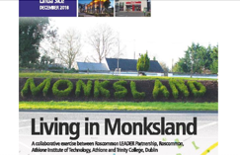
Empathy
Organization name who initiated the project:
Roscommon LEADER Partnership, Athlone Institute of Technology and Trinity College Dublin
Project name:
Living in Monksland
Location: town, country:
Monksland, Athlone, Co. Roscommon, Ireland
CLICK TO VIEW
About the project:
Work with the Community of Monksland began in 2017. The settlement of Monksland is located on the outskirts of the large urban town of Athlone. Athlone is in the County of Westmeath, however, Monksland is in the Athlone West Electoral Division within the County Roscommon. The residential development in Monksland is dense. Agencies in the Community Voluntary and Statutory Sector have for many years wanted to support community, social and economic development in what is the largest settlement in County Roscommon. This eventually led to the development of a partnership approach to establishing the need within the area. The collaborative partners leading this research are Roscommon LEADER Partnership, Athlone Institute of Technology, Trinity College Dublin, Roscommon County Council and locally Monksland Town Team.
The primary rationale for this study was to establish the needs of the Community in Monksland, and by so doing to use the information gleaned as an evidence base to develop a Strategic Action Plan of targeted interventions for the Community of Monksland.
The research set out to examine Monksland under a number of different categories
Monksland as a Place to Live
Monksland as a Social Community and
Monksland as an Economic Community
The basis for this research is to explore the needs of the local residents in the Monksland area. This project is firmly grounded in Community Development Principles. This action provides the community with the evidence base to act collectively to address their needs and affect social change. Community Development aims to improve the life situations of the community, and that all projects and programmes are led from the bottom up and prioritised as a result of a felt or expressed need in the area. The premise behind the prioritisation of initiatives from a community development perspective is that all community development initiatives should, in theory, be initiated as a result of an expressed need from the Community with the active participation by the socially excluded in the development process. These community development principles are fully illustrated within this project.

Slide 56

Who is involved?
Monksland is a large urban area on the outskirts of a very sizable town.
Large scale Industrial as well as Business, Industry and Warehousing developments are prevalent in Monksland with limited provision of social and community facilities.
The initiative was driven locally by Monksland Town Team. Monksland Town Team was established by Roscommon County Council (RCC) in 2012 to support the revival and re-branding of Monksland. The objective of Monksland Town Team is to facilitate engagement with RCC and other agencies to identify the key economic, social, and cultural & community opportunities for development.
481 individuals participated in the research from households that were chosen based on stratified random sampling by housing estate. Every 3rd house was surveyed from a housing stock of 1400 units in the Monksland Area. Of the respondents 7% were under 25 years, 32% were in the age range of 26 to 35, 34% were between 36 years and 45 years, 17% interviewees were in the bracket 46 to 55, 4% of those interviewed were in the age range of 56 to 65 and finally 6% were 66 years and older.
28% were living in single adult household, 66% lived in a 2-adult household, 5% lived in a 3 adult household with a further 1% shared their home with 3 other housemates.
28% of the respondents were single, 57% were married, 8% separated, 2% divorced, 3% were widowed with the remaining 2% in civil partnerships.

Slide 57

Why it is a good practice?
There was extensive engagement with the community in Monksland and their representative body; Monksland Town Teams for a significant period of time to understand the needs of the community and those residing there, and to ensure the research study would accurately reflect the needs of the residents. Engagement tools included bi-weekly meetings, walk arounds and meeting individuals to establish their perspectives, to see what they see, to try to understand what they feel and for those engaged in the research to submerge themselves as much as possible within the Community to observe how the members of the community are living.
Through use of this methodology, it allowed the project partners to build empathy and understanding, to put aside their own preconceptions and views and to understand the ideas, thoughts and needs of the residents of the area instead.
It allowed those involved to get a very real understanding of challenges, difficulties and realities of the residents living in Monksland from a societal, educational and employment perspective.
This project provided the opportunity to gather a substantial amount of information about Monksland as a place to live, a social and economic community. This initiative clearly demonstrates the importance and value of the Empathy Stage of Design Thinking. It demonstrates how the development of Empathy provides for the best possible understanding of the community,
their needs and the problems that underlie addressing these needs and affecting real social change in the area.
In order for this project to fully understand the needs of this community it immersed itself in the Community, it outreached into the Community holding regular meetings with the residents, and activists to establish the needs, thus allowing for a completely different perspective on the needs for the community.
During the empathy stage this initiative delves deep into the Community to gain real insight into community and their needs. It focuses on user-centric research, allowing the agencies to gain an empathic understanding of the problem they are trying to solve in partnership with the Community. This projects allows the research to identify the real needs and the realities faced by this community through extensive interviewing and immersion within the Community, it continues to present the data on the needs of the community across societal and economic life, and by ensuring fidelity to the empathy stage a very real understanding of the Community of Monksland, thus allowing for the crafting of design solutions and actions which meet their expressed and felt needs, societally, educationally and economically.

Slide 58


What difference is the project making on society?
As a result of the engagement, and development of a local group to support the development of the research report the group went on to hold a stakeholder meeting with 43 key decision makers present including educators, planners, influencers and policy makers and local authority.
The group went on to develop a plan of action and have implemented a considerable number of actions based on the identification of needs including the securing of a dedicated youth service for the young people 1 day per week, Summer programmes, education and training courses, and a jobs fair.
This research was also used as a means of securing additional funding to meet the needs of the community identified in the report, including funding to develop a skateboard park for the Monksland area.
In what of the 5 key steps of the design thinking process (empathy, definition, ideation, prototype, test, storytelling) this action is inspirational?
Empathy
Images/video/documents resources:
http://www.rosleaderpartnership.ie/docstore/dls/pages_list/monksland-final-research-report-june-2019-274.pdf
CLICK TO VIEW

Slide 59

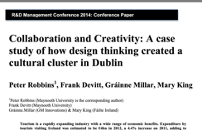
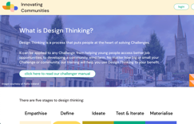
Definition
Organization name who initiated the project:
Fáilte Ireland
Project name:
Merrion Square: a source of a cultural cluster in Dublin, through design thinking
Location: town, country:
Merrion Square is a striking Georgian Square and public park located very close to the centre of Dublin, surrounded by attractions such as The Natural History Museum, The National Gallery, and numerous creative organisations and businesses.
CLICK TO VIEW
Web/social media links:
*This case study is entirely based on two sources which must be clearly quoted:
http://mural.maynoothuniversity.ie/6365/1/PR-Collaboration-Creativity.pdf
(TO QUOTE THIS SOURCE: R&D Management Conference 2014: Conference Paper - Collaboration and Creativity: A case study of how design thinking created a cultural cluster in Dublin Peter Robbins 1, Frank Devitt, Gráinne Millar, Mary King)
and https://www.innovating.ie/design-thinking
About the project:
From the beginning, the Merrion Square project adopted an open innovation strategy, to engage a wide group of local stakeholders (both cultural and hospitality) and other potentially interested organisations and to encourage new thinking and ideas about the opportunities for collective tourism development that might be available by coordinating the rich heritage of the institutions
and organisations located in the Merrion Square area. The challenge was to develop a model for clustering cultural organisations in Merrion Square to build and strengthen the sense of place, identity and community, to capture what is unique and distinctive about this part of the city and to release (and enhance) the potential of the Network’s constituent organisation
CLICK TO VIEW

Slide 60

Who is involved?
The Merrion Square Innovation Network (MSIN) which is the subject of this paper, is a group of 36 stakeholders from the cultural and hospitality sector who were brought together by the good offices of Mary King and Gráinne Millar to begin to develop the Merrion Square area in Dublin as an attractive, more integrated and vibrant cultural tourism destination for Dublin.
Why it is a good practice?
This project specifically set out to find a creative and collaborative way of working, with the aim of developing Merrion Square as a new, dynamic and appealing centre for cultural tourism in Dublin. An essential part of realising this ambition required that the various stakeholders in Merrion Square be bought together and engaged in developing a palette of new, customer-centred ideas to connect the various culturing offerings around the square.
What difference is the project making on society?
Design Thinking is not only a process but also a way of working. To do it well demands close collaboration and this had enormous benefits for a group of independent organisations with disparate missions, who shared only a prestige location and an appetite for development. Once on this programme, the participants worked well together, learning new skills like customer insight, ideation, prototype development.
The Merrion Square project has been a pilot for a new network innovation brokering concept for Fáilte Ireland. Fáilte Ireland was the funder for this project, although the funding requirement was very limited. Moreover, organisations like to work with Fáilte Ireland as it connects them formally with possible sources of future funding or revenue through such collaboration. In terms of
transferability, having a sponsor for such a project seems important.
Another positive influence was the involvement of Gráinne Millar who had a strong track record in creative cluster development and had been responsible for a major cultural collaborations project before. Gráinne had brought Culture Night successfully into Dublin and beyond. She had wide and valuable experience in getting cultural institutions to collaborate in an overarching project.
The process itself, though, and the collaboration it demands are transferable to many contexts.

Slide 61

In what of the 5 key steps of the design thinking process (empathy, definition, ideation, prototype, test, storytelling) this action is inspirational?
Observe For stage two, the second workshop, the group, were divided into four teams, and were asked to ‘get under the skin of a typical customer’. The themes for each of the four teams were deliberate with each one representing a key customer segment. They were given examples of ‘personas’ and shown customer segmentation maps. Each team was asked to do a little ethnographic research and to observe and photograph visitors to the square. They were to return to the next workshop with some photographs; some observations and during the workshop, these observations would be converted to meaningful insights. Each team then developed a very vivid portrait of a customer segment, complete with an ethnography board showing examples of this type of customer.
A guest presenter was also invited to this workshop – the head of a large tour operator whose business it is to sell Dublin tours in the US and has made a successful career from understanding and providing what tourists want when they visit Dublin. The speaker made it very clear that the Merrion Square experience is far from best-in-class; she noted that Americans were looking for bespoke experiences which she referred to as ‘behind the rope’ tours where they would get access to behind the scenes in various tourist attractions. Merrion Square with its closed doors was not aligned to the wants and needs of the modern tourist. This workshop was centred on putting the customer first; on forcing the institutions to think ‘outside-in’ rather than the other way round. Thinking from the users’ point of view was definitely a new lens for many of the delegates and this day had a significant impact on the rest of the process. The Dublin Civic Trust also spoke to the group that day and they made explicit the need to balance the ideas for future development with the need not to compromise the distinct and valuable heritage attached to Merrion Square. This speaker put the square into an historical context and emphasised that while it may be imperfect as a tourist experience: it was almost perfect enough to earn a place on the tentative list of world heritage sites because of its intact Georgian architecture. Ideate & Prototype (What-if?) Workshop three followed two weeks later and it kept the participants in their teams; each team had an archetypal customer representing a significant market segment. The purpose of the session was to use various techniques to elicit ideas for each segment. To start the day, a Futurologist was brought in to address the issue of consumer trends and to articulate which ones were likely to impact most on tourist wants, needs and behaviours in the medium term. This provided an interesting springboard from which to break into generating new, high potential ideas. A key feature of this workshop was the presence of a professional graphic artist who attended the session to record in illustration all of the key ideas. The graphic artist captured all the ideas on A2 artboard and created colourful graphic interpretations of each of the ideas. These illustrations acted as vivid visual prototypes of the ideas.
Images/video/documents resources:
VIDEO:
https://www.youtube.com/watch?v=d8g1krkY8q4
CLICK TO WATCH

Slide 62

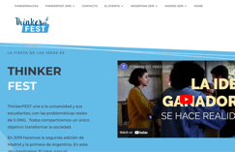
Ideation
Organization name who initiated the project:
Thinkerfest and the Complutense University of Madrid.
Project name:
Thinkerfest
Location: town, country:
Madrid (Spain)
CLICK TO VIEW
About the project:
Thinker fest is an event where around one hundred students will produce ideas to solve real challenges provided by NGOs. The project has principal actors: students, universities, NGOs, and companies.
Students apply innovation and creativity, creating a common space to develop ideas and give solutions to concrete problems of the third sector.
Who is involved?
Students
NGOs
Companies
The University
Why it is a good practice?
The project empowers students through Design Thinking to create innovative ideas to solve a diversity of problems or challenges provided by the NGOs. It allows the University to be at the centre of innovation, letting the students to work with challenges. It highlights prototypes that are supplied for companies to seek for financial support. In concrete, the project has created a solid foundation for the stakeholders to meet their needs and work collaboratively to find a common solution.
What difference is the project making on society?
It created an ecosystem where a diversity of stakeholders meets to work on solutions using their experiences.

Slide 63


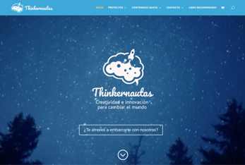
In what of the 5 key steps of the design thinking process (empathy, definition, ideation, prototype, test, storytelling) this action is inspirational?
During the ideation phase, students use different techniques to generate as many ideas as possible. Likewise, once they have prioritized their ideas, they will have to choose one or two to improve it and, finally, present the solution to the target audience. At the end, students will have 5 minutes to present their idea to the jury composed by representatives of the NGOs, companies, and staff members.
CLICK TO VIEW
Images/video/documents resources:
https://thinkernautas.com/

Slide 64

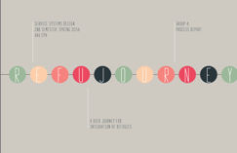
Prototyping
Organization name who initiated the project:
Aalborg University Copenhagen
Project name:
Refujourney - a user journey for integration
Location: town, country:
Copenhagen
CLICK TO VIEW
About the project:
This report outlines the service concept developed in course of the main project of the 2nd Semester in the Service Systems Design Master at Aalborg University in 2016. The concept created is focused on the topic migration, refugees, and open data. The result is the creation of Refujourney, a service that provides guidance and support in the different steps every individual refugee arriving in Denmark must go through. Refujourney offers a mobile app that helps refugees get an overview of the steps that await them when arriving in Denmark. By providing useful information about rights and opportunities in their individual situations, Refujourney provides the best possible support and makes processes more transparent and understandable for refugees. Refujourney draws on open data for the app content and creates big data as it allows the service provider to generate up-to-date statistics based on user data.
Using a human centred design approach, refugees, and asylum seekers currently living in Denmark, have been participating in cocreation sessions as
well as end-user prototype testing. The research conducted has been based on desktop research, qualitative interviews, and expert interviews. A wide range of Service Design tools and methods have been used to shape the service concept.

Slide 65

Who is involved?
The project group consist of 5 members, all with different academic backgrounds and representing four nationalities. These differences enable the group to apply a range of different professional, cultural and personal viewpoints to the design process. “The term interdisciplinary refers to problem solving activities that involve interactively, and to some extent integrate, at least two different disciplinary perspectives to the problem at hand”. The advantages of tackling complex challenges in an interdisciplinary collaboration are many. Not only is there a possibility of a theoretical and methodological interdisciplinary collaboration. Also, an instrumental and critical interdisciplinarity is in the scope of this project. These different forms of interdisciplinarity can be described as enablers to mix disciplines and an attempt to challenge the dominating structures, habits, or norms in the disciplines. Hereby the project group aims to reach a higher degree of social creativity.
From the findings of the desktop research and the interviews that were conducted, the project group learned that the refugees that come to Denmark are a broad group of people, represented by different nationalities, genders and age. As designing for a specific target group demands specific requirements, such as appropriate language and content, the project group decided that the service would be designed for a broad group of refugees aged between 18 up to 59 years old. Variables such as gender, country, level of education (if literate) and work background are not so relevant in this case, as the problems that the refugees face once arriving in Denmark are shared by a variety of people. Keeping the target group broad also allows the service to be adjustable to different user needs and purposes, which adds a major value to the service.

Slide 66

Why it is a good practice?
Migration has happened for centuries and the human curiosity and belief in achieving better living standards by moving towards better conditions, has been occurring for centuries. However, the forced migration and the migration due to humanitarian crises has been very significant for the beginning of the 21st century and the migration pattern has been changing vastly during the last decades. This has forced countries to rethink their political decisions involving refugees and the traditional thinking of borders and integration processes demands the development of new systems. Due to the internet, connectivity of people worldwide increases - we now see a completely new way of interaction between civil societies, countries, and official government systems. Organizations such as UNHCR (UN Agency for Refugees) and IOM (International Organisation of Migration) are now in the beginning phases of adjusting their organisational systems to better understand the new complexities of migration. (theguardian.com, 2012) Another aspect of the 21st century migration is the number of refugees migrating from specific countries in crisis. Here the use of new technology has become an addition to their journey. Especially the use of smartphones has been one of the main impacts in dealing with the European refugee crisis. (cnbc.com, 2016) Furthermore, several services and functions have proved to be very important in their journey, such as the German website “Refugees Welcome”, as well as the messaging services and intranet group systems provided by Facebook. This vast number of services used by refugees to either locate or relocate themselves has been an important role in
making refugees help themselves and each other. However, questions must be posed: does it help them in the long term? Do these internet services contribute to create a better society? The use of mobile technology, ultimately in the refugee crisis, state how effective digital services can be for refugees.
As service designers, the project group aims to provide the refugees with a system that will help them understand their situation while also easing the burden on the bureaucratic asylum processes in Denmark. Furthermore, the project group will take into account the national rights and regulations to present a plausible service solution

Slide 67
What difference is the project making on society?
It aims to the transition from home country to new country easier for refugees, by providing them with a guide on how to approach the bureaucratic asylum processes that they will encounter. This promotes social inclusion and take the stress of incoming refugees.
Images/video/documents resources:
https://www.servicedesign.aau.dk/digitalAssets/291/291344_process_product_report_group_4_refujourney.pdf
In what of the 5 key steps of the design thinking process (empathy, definition, ideation, prototype, test, storytelling) this action is inspirational?
CLICK TO VIEW
Workshops – Two practical workshops from the Service Systems Design Masters took place. In course of these, the project group had the chance to investigate the service idea further using Video sketching methods as well as the Arduino technology.
UI Sketching – Based on the theoretical framework provided by Bill Buxton (2007) and his approach of thinking through sketching, the group began to sketch out the initial functionality of the app based on the key findings from the interviews and desktop research. Each group member sketched out their initial thoughts by creating individual screens of how the app could look like. It initiated some valuable discussions and hereby the project group reached a common understanding of the design of the application.
Co-Creation / Testing Session – Co-Creation / Testing Session The group conducted a usability test, using the paper sketches from the sketching sessions as the initial UI. For this
matter the same refugees who were involved in the co-creation of the journey timeline earlier in the process, were invited. The testing was conducted at a public space (Copenhagen Central Library), where the project group divided the invited focus group into individual testing. The group then ran through the usability of the paper prototype with each test person individually.
Expert interview (Testing of Concept) – To test the Refujourney concept it was decided to reach out to an expert in the field. Someone who could provide the project group with critical reflections and insights on what content would be appropriate to include in the service
Digital and interactive UI Prototype - After having the testing session with the refugees and the interview with the expert in refugee issues, the project group analysed the feedback that was given, to implement some changes in the new prototype. As Refujourney is mainly a digital service, the project group considered it important to develop a digital prototype, that would give a more similar experience to what is intended in the final version. The plan was to make an interactive and high-fidelity prototype, which could be used for testing as well as to be presented to stakeholders. The screens were designed in Photoshop and the interaction flow was created using InVision
The whole project is an inspirational use of the design thinking process, but in particularly the prototyping stage. They were innovative in their methods, which included:

Slide 68

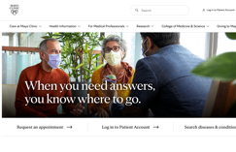
Testing
Organization name who initiated the project:
Mayo Clinic – Centre for Innovat
Project name:
Mayo Clinic – Centre for Innovation
Location: town, country:
Rochester, Minnesota, USA
CLICK TO VIEW
About the project:
The project started from 2002 with a lab called SPARC, generally it is a lab which test hypothesis about new ways of interaction between health professional and patients.
Six years of experiences later they evolve into a Centre for Innovation (CFI).
The main methodology of this procedure contains 5 steps: planning, research, synthesis, prototyping and implementation.
So generally during these 5 steps firstly the did research about the general state of the health care system, then they did 40 interviews with patients and health professionals so that they can better understanding the general needs. The prototyping stage they will co-create and then test with all their health professionals and later they made the final proposal.
This method helps the Mayo Clinic one of the most patient-centred health institution and made them classed the best hospital in USA during 2020-2021.
Who is involved?
surgical patients
health professionals involved in the perioperative
surgery centres, hospitals which provide perioperative services

Slide 69

Why it is a good practice?
First of all, they innovated the traditional way of doctor-patient consultation, from hospital-centred to patient-centred. I have logged on the hospital's website to make an appointment. Before making an appointment with a doctor, I need to answer questions about the patient's health. To help doctors understand the patient's situation in advance and reduce the time needed for basic information consultation.
Secondly, because of its patient-centric mechanism, the company's appointment procedure is concise but to the point, which can help patients find the most suitable doctor in the fastest time.
The most innovative thing is that the hospital's website even has the function of searching for diseases, helping the patients who have been diagnosed to understand their basic conditions.
What difference is the project making on society?
This patient-centred model improves the efficiency of the patient's visit, and prior investigation of prior medical history not only reduces the time cost of the doctor's enquiry, but also reduces the risk of misdiagnosis of the disease. At the same time, this efficient triage model allows the hospital to help more patients in an efficient time frame and will reduce the risk of patients being overwhelmed when seeking treatment. In a general way, this method improves health awareness and health knowledge, which participate to social change in the way that a better health for citizens help them be more involve and active in the society.
In what of the 5 key steps of the design thinking process (empathy, definition, ideation, prototype, test, storytelling) this action is inspirational?
The prototype procedure was divided into two steps: prototyping and deepening.
This kind of method allows the real patients and health professionals to give feedbacks and then help them to modify their proposal. Which reduced the potential of mal functioning.
Images/video/documents resources:
https://www.mayoclinic.org/
CLICK TO VIEW

Slide 70
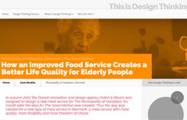
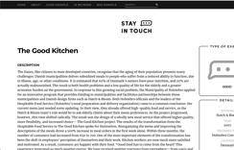
Storytelling
CLICK TO VIEW
Organization name who initiated the project:
Client: Municipality of Holstebro
Agency: Hatch & Bloom
Project name:
Rethinking Subsidized Meals for the Elderly at The Good Kitchen
Location: town, country:
Denmark
CLICK TO VIEW
About the project:
Improved food service equates to a higher quality of life for the elderly. So, in the fall of 2007, the Municipality of Holstebro commissioned the Danish idea- and design firm Hatch & Bloom to build a new food service. Six months later, the idea for The Good Kitchen emerged. A new type of meal service with more quality, adaptability, and freedom of choice was thus made possible in Denmark.
This design thinking case study employed design tools to undertake ethnographic research in the context of social services in order to ask questions, comprehend, observe, and know about the lives of old people that we may otherwise overlook.
Methodologies:
Participatory Observations
Before constructing The Good Kitchen, Hatch & Bloom's design anthropologists undertook a complete ethnographic identification of the seniors' behaviour, wants, and wishes, including unmet and unspoken requirements. In addition,
interviews with key experts were held to understand the kitchen staff's needs.
User workshops and idea development,
Hatch & Bloom designed and supervised a series of workshops with representatives from all user groups and interested parties during the creation of The Good Kitchen. The goal was to collaborate on developing ideas for a new and improved lunch service using several creative idea creation approaches, including the method "Radical Analogies." Consider the meal service as a service for a family with children or as a restaurant, and you'll have the concept for a new name and image.
Design Participation
The Good Kitchen's various design solutions are developed through organised iterations between design- and feedback studies, including user workshops, collaborative design processes, and testing of user-friendliness with prototypes and mock-ups. This ensured design solutions with a high level of usability and applicability.

Slide 71

Who is involved?
Around 125,000 seniors use meal service. This figure will skyrocket as the overall number of seniors over the age of 67 rises over the next ten years. This situation implies new and high standards for food quality and menu variety. Almost all seniors are in danger of contracting a disease due to poor or incorrect nutrition.
Target Group:
Municipality of Holstebro, who takes decision
Kitchen workers
Elderly citizens of Denmark.
Another crucial part of the initiative was the social shame associated with even needing such support in Danish society.
Why it is a good practice?
In the context of Denmark, this effort addressed a more significant societal issue. Public kitchens are prevalent around the world. In some nations with elderly populations, the entire project's architecture can be modified to handle such complex socioeconomic issues affecting older individuals.
The unique design methods used for this project's ethnography research may be applicable to addressing a similar societal challenge like malnutrition of the elderly.
Of Sweden's 10 million residents, 20% have reached the standard retirement age of 65. This figure is expected to climb to 23% by 2040, partly due to the enormous number of Swedes born in the 1940s (https://sweden.se/life/society/elderly-care-in-sweden).
In South Asian and European nations, the industrial revolution and urbanization have fundamentally altered how families are understood. Senior citizens are mistreated as a result of the failing joint family system. Due to the breakdown of the joint family system and the rise of the nuclear family, society has a problem providing for the physical and emotional needs of the elderly. As a result, we can see the public and private support systems, such as NGOs and Old-Age Homes.

Slide 72
Images/video/documents resources:
https://www.mayoclinic.org/
In what of the 5 key steps of the design thinking process (empathy, definition, ideation, prototype, test, storytelling) this action is inspirational?
http://stayintouch.design/en/component/content/article/9-good/136-the-good-kitchen?Itemid=437
CLICK TO VIEW
Phase 1: Empathize
This project helps to solve a difficult challenge in the social sector. The Municipality also assumed that we merely needed to design a new menu for the public kitchen when we began this project. During the empathy stage, designers employ user observations, interviews, and journey mapping to delve deep into seniors' behaviour, wants, and desires in order to understand their existing circumstances and unarticulated demands.
Phase 2: Define + Phase 3: Ideate
The design team conducted three workshops
Workshop 1:
The first session brought together municipal officials, volunteers, aged issues experts, kitchen workers, and residential care home employees. The workshop's goal was strategic: to raise awareness of the issue and create a shared perspective as the group worked to address it. There hasn't been any discussion about remedies yet.
Workshop 2:
During the second session, facilitators and participants employed a mind-mapping approach, first categorizing the major discoveries and observations acquired during the define phase, such as food delivery or menu composition.
They then dug deeper, investigating the insights that emerged from each category and what they could reveal about the design criteria of an ideal solution. Analogies were utilized as trigger questions by facilitators to help modify participants' mental models.
Phase 4: Prototype + Phase 5: Test
The third workshop, which was considerably more hands-on, focused on prototyping and putting the co-created solutions to the test. Hatch & Bloom collaborated with participants on three distinct menu versions, asking them which they preferred and how they felt about various things such as which colours they preferred and whether they wanted photographs or illustrations.
Testing prototypes with various combinations and ways of presenting food with clients they had been observing since the start of the project. They evaluated the prototypes not only with current clients, but also with those who had stopped using the service and those approaching retirement age.
Storytelling is extremely important in the Design Thinking process. Storytelling builds a captivating narrative around the people we're designing for, allowing us to get a deep and emotional understanding of their motivations and wants. In this case study, beginning with the elderly and kitchen employees, the design team heard profound emotion tales about their sentiments, dealing with public opinion, and social stigma.
The ethnographic observation, mind mapping, and co-creation processes engaging stakeholders, as well as iterative prototyping and testing resulting in a slew of significant changes: a new menu, new outfits for a team, a new feedback system, and an overall new experience for both consumers and kitchen employees
The whole project is an inspirational use of the design thinking process, but in particularly the prototyping stage. They were innovative in their methods, which included:

Slide 73
10
Learn More

Slide 74

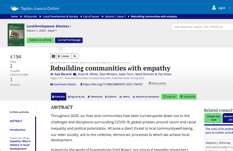
Learn more about Design Thinking as a concept
The following are links to useful articles on Design Thinking and the Design Thinking process across the various Countries involved in this project.
Rebuilding communities with empathy
This article focused on the impact of covid-19, racism, and inequality on our communities in 2020, and the impact and threat they pose to community well-being. The article builds on the work of Fred Rogers who evidenced the need for empathy, kindness, and compassion as a basis for productive communities. The article identifies that active empathy can lead to greater social competence. This is the type of empathy that builds strong communities, especially during times of crises where moments to help are more clearly identified. The article details how empathy for others and its associated prosocial behaviours are key facilitators of positive social understanding, which strengthen communities by supporting anyone who feels vulnerable. The article identifies empathetic actions taken during theCOVID-19 global pandemic, originated from people being able to listen, understand, and see themselves in another’s life story. These acts of empathy come from a place of understanding, as individuals look to make a ripple in the lives of others and across neighbourhoods and communities. Similarly, acts of anger, frustration, and victim blaming are based on a lack of empathy, resulting in chaos, increased virus spread, and the elimination of constructive paths forward. It illustrates that it is in the best interest of local communities and the wider society to practice empathy. Through empathic interactions, a sense of collective purpose, action, and social participation grow in communities with empathy at the core. Ultimately, individual and collective empathic acts lead us toward resilient communities. The article concludes by inviting community leaders to continue to engage in social change with empathy at the heart of it by:
Allowinga space for citizens’ voices to be heard
Offer an empathy education or human interactions course regularly in communities
CLICK TO VIEW

Slide 75

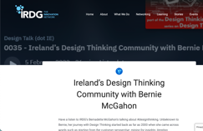
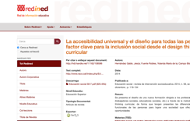
Ireland’s Design Thinking Community with Bernie McGahon
An expert journey with Design Thinking process, including an overview of how design thinking mainly functions for businesses in Ireland. This knowledge can be used and is transferable for other areas, such as social change, so it is advisable to hear from the business expert, of how useful this method is in Ireland.
Whereas the European Commission has been concerned about the progressive inclusion of ̈Design for all ̈ into the curriculums of higher education, Universal accessibility does not bring up an academic discipline itself with a solid curriculum. Therefore, it is necessary to present new concepts to achieve better professional capacitation for the future professionals through the synergies with professionals that sensibilize the university community with the necessity of including transversal subjects that integrate the person with his environment, enabling the necessary tools for Design for all(Hernández et all, 2014).Design Thinking appears to be a suitable method for seeking new ways of transdisciplinary intervention, creating innovative solutions to solve problems, and exploring new opportunities and weaknesses. Concluding the article, by
embracing the European guidelines for incorporating Design for all into all grades, the authors propose a comprehensive educational and political approach to the rapid change that societies are undergoing and how upcoming paradigms like Design for all can help answer these current trends.
Universal Accessibility and Design for All as a Key Factor for Social Inclusion on the Basis of Curricular Design Thinking
CLICK TO VIEW
CLICK TO VIEW

Slide 76

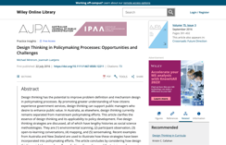
Design Thinking in Policymaking Processes: Opportunities and Challenges
Design thinking has the potential to improve problem definition and mechanism design in policymaking processes. By promoting greater understanding of how citizens experience government services, design thinking can support public managers who desire to enhance public value. In Australia, as elsewhere, design thinking currently remains separated from mainstream policymaking efforts. This article clarifies the essence of design thinking and its applicability to policy development. Five design thinking strategies are discussed, all of which have lengthy histories as social science methodologies. They are (1) environmental scanning, (2) participant observation, (3) open-to-learning conversations, (4) mapping, and (5) sensemaking. Recent examples from Australia and New Zealand are used to illustrate how these strategies have been incorporated into policymaking efforts. The article concludes by considering how design thinking might be more broadly applied in policymaking, and the training and resourcing requirements that would entail.
CLICK TO VIEW
Sustainable heritage Spaces case study
The Santos is an area situated in Lisbon, Portugal. It is an area full of beautiful site but also with difficulties like short of maintenance and decrease of population. Through a methodology originated in strategic design, urban design, and human-centred design, they tried to generate different ideas to promote the development of this neighbourhood.
Research of potential heritage sites
Cultural research and analysis of a heritage site in Lisbon; Santos
Identification and involvement of stakeholders
Analysis and identification of the potential in Santos
Workshop in Malta and comparing heritage sites in Malta with Santos
Development of design concepts This logic of design thinking allowed them to generate successfully the potential of the site and proposed a sequence of measures to revitalise Santos and help inhabitants to connect better.
Design 8-Strategy Spring 2022 Supervisor: AndréLiem

Slide 77
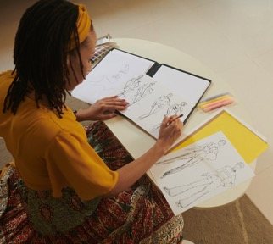
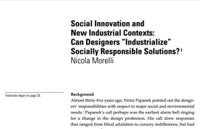
Social innovation in fashion design Can design provide opportunities of inclusion for refugees in Greece?
This research thesis seeks to answer the question, "Can clothing design provide a means of inclusion for refugees in Greece?" Background information According to UNHCR data, about 60.000 war refugees are still stranded in Greece, with no plan to improve their living conditions, education, or work. Design thinking as a social change tool Through the exchange of culture, knowledge, and skills, a design thinking technique paired with the experience of social organizations could produce new possibilities of inclusion in Greek society. This exchange, which begins as an educational exercise, has the potential to generate entrepreneurial businesses and novel relationships. The result of this work gives an economic income in the end, create employment prospects, and serve as a catalyst for conversation between Greek society and refugees. Methodology: a co-design session was used to investigate the Hypothesis. To test this idea in practice, a month-long co-design session was held at Ankaa, a non-profit educational centre for refugees in Athens. By completing a one-month workshop with refugees, researchers collaborated with them to address refugees who had already expressed an interest in manufacturing garments. Workshops Goal to introduce participants to design thinking and let them express themselves through various handicrafts on clothing Empathy: Participants' personal stories inspire the creation of prototypes. This technique results in prototypes with an original character derived from personal stories, which have extra marketing value as a product. The long-term purpose of this session was to examine the participants and their potential, as well as the space and equipment available, and to build an organized educational offer that meets their needs. Study Implication More people are being displaced by conflict and crises than at any point since World War II. This study focuses on refugees in Greece, however the overall strategy of co-design and giving new employment and integrating chances may be applied to any of these circumstances. Similarly, design thinking and the numerous labs in Ankaa can be merged to serve various fields such as housing and have a significant impact on people's daily lives.
CLICK TO VIEW

Slide 78








European Center for Human Rights (FR)
Partners
Le Laba (FR)
European E-Learning Institute (DA)
Roscommon Integrated Development (IR)
Dramblys (ES)
I-Strategies (IT)
Momentum Marketing Services Limited (IR)
www.socialchange.how
follow your journey

