Slide 1


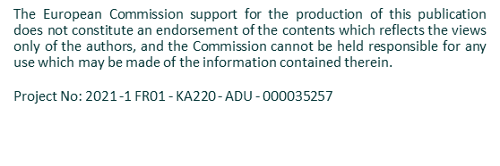
Facilitator Guide to our
Open Education Resources – Training Course
www.socialchange.how
guide to design for change OER training course

Slide 2


contents
1.0
Welcome
2.0
About the Open Education Resources – Training Course
3.0
General instructions for Educators
4.0
Course Delivery Options
4.1
What the Modules cover
5.0
Course content overview
6.0
Sample timetable
Design for Change Open Educational Resources © 2023 by Design for Social Change Partnership is licensed under CC BY-SA 4.0

Slide 3
01
WELCOME TO
Design Thinking for Social Change

Slide 4

About our Project
Design thinking is a human-centred and collaborative approach to problem-solving, using a designed mindset to solve complex problems
TIM BROWN
Design For Change is an ERASMUS+ project which provides Adult Educators, Social Change Actors, Policy Stakeholders, and other stakeholders involved in social change with the tools to use Design Thinking principles as a standard when
deciding on priority issues,
determining who is affected by community problems and how,
determining what solutions are possible and
how they affect beneficiaries, developing ideas, and implementing projects.
The Design Thinking method will help to make better use of resources and financing, as well as educate staff, members, and activists in local governments, NGOs, development agencies, and organisations, improving the position of community changemakers and civil society to address major community concerns.

Slide 5
Overview
The EU is moving, changing, reinventing itself in the face of new challenges that can be both institutional (e.g. democratic gap) and circumstantial (e.g. pandemic, poverty, financial crisis and security challenges), always investing in new solutions and progress to elevate the social change. And within that, communities are diverse and difficult to comprehend, and often, top-down solutions are not tailor made and fitting to our communities and actual issues within those communities.
The Design Thinking approach allows individuals from various backgrounds to work together to solve problems within their community. Setting context and getting a clear understanding of the needs and challenges within the community is imperative when exploring ideas and solutions. There is a need for adult educators, NGOs and activists to be involved in the problem-solving processes on an equitable basis to adopt a new way of thinking and designing solutions – Design Thinking for Social Change.
OVERVIEW OF OUR RESOURCES
01 Toolkit to establish a Learning Centre for Social Change
A toolkit to establish Design Thinking Learning Centres for social change. It focuses on how Design Thinking can upskill social change agents, creating centres for learning in communities. ACCESS via A Toolkit Guide to Design for Change - Design For Change (socialchange.how)
02 Design Thinking for Social Change Guide
The Guide supports the Erasmus+ priority of improving the competences of educators and other adult education staff to facilitate the creation of effective, and long-lasting solutions through providing a range of tools for adult educations for each stage of Design Thinking model to understand and articulate the needs of communities crying out for social change.
03 DESIGN FOR CHANGE Open Education Resources – a Training Course + Facilitator
The Open Education Resources empower Adult Educators, Social Change Actors and Policy Stakeholders involved in creating social change to upskill change advocates via a set of OERs – a Training Course + this Facilitator’s Guide to enable adult educators to adopt and pass on the skills of Design Thinking to social change activists and community members.
04 Design Thinking for Social Change Process Learning Platform
The interactive learning platform is a creative space for the exchange of ideas between social change agents that use design thinking principles. ACCESS via https://socialchange.how/learning-platform/
.

Slide 6

Who will benefit?
Adult Educators
Will be better equipped and involved in their communities in addressing Social Change through Design Thinking. They will now be able to actively participate and be involved in the problem-solving processes by educating a new way of thinking and designing solutions.
1
Adult Learners
2
Adult learners will access high-quality learning opportunities, utilising Design for Change's innovative storytelling approach to understand and solve community problems, catalysing social change.
Social Change Actors
3
Will be equipped with Design for Change resources, learning environments and methods for civic participation and be able to identify and solve key community problems. Becoming Community Change Makers, empowered to tackle key community issues and develop inclusive, stronger communities.

Slide 7
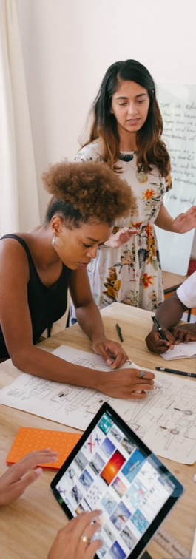
Policy Makers,
Government Decision Makers, National Development Agencies, Funding Authorities.
Will have access to grassroots social inclusion Learning Centres across Europe. Fostering and promoting Social inclusion, Civic engagement and democracy. They will witness the transformative effects on communities, individuals, and local economies, while also benefiting from high-quality training support and collaboration opportunities.
4

Slide 8







Meet the Team – Who is involved.
Roscommon Leader Partnership (RLP) – Ireland are a progressive local and rural development agency of voluntary, community and statutory bodies. They seek to champion needs responsive, local yet outward looking development initiatives which focus on improving the quality of life in Co. Roscommon for all.
ECHR, France The European Centre for Human Rights (ECHR) is an independent, non-profit legal and educational networking
organisation dedicated to protecting civil and human rights. ECHR engages in innovative strategic litigation, using European, international and national law to enforce human rights and to hold state and non-state actors accountable for egregious abuses.
Le Laba, France is a centre of expertise for the New Aquitaine Region in France. This innovative cluster unites 20 networks of operators across various fields, including culture, education, inclusion of migrants, and digital initiatives.
Momentum, Ireland is an award-winning Irish educator focused on developing progressive learning programmes (course curriculum and content development) and platforms for education, with a special focus on sustainability, community regeneration, innovation, and marketing.
European E-Learning Institute – Denmark are specialists in online learning who are committed to providing high-quality learning experiences and innovative educational programmes which engage learners from a range of sectors and socio-economic backgrounds.
i-strategies, Italy is a start-up company based in Offida, that offer learning in digital storytelling for communities, entrepreneurs, heritage sites, universities, and Research and Innovation projects.
Dramblys, Spain is a non-profit organisation located in Spain that works for the promotion of social innovation. They combine
sociological imagination & inquiry with social creativity and design to approach, explore, and innovate solutions to
contribute to sustainable development.

Slide 9
02
The Open Education Resources
Curriculum

Slide 10
2.0 About the Project Curriculum and OERs
The Design for Change Open Education Resources, embrace innovative Challenge Based Learning techniques, designed to educate people and businesses to utilise Design Thinking in their everyday lives. Design for Change Open Educational Resources are created for teachers, trainers, and local communities, in open access format, and are free to download.
HOW YOU WILL BENEFIT?
Design for Change will contribute to your professional development as Adult Educators/ Trainers, by increasing your knowledge and skills in relation to Design Thinking and its six principles of Empathy, Define, Ideate, Prototype, Test and Storytelling.
As educators, we respond to the needs of communities and adults interested in promoting Social Change. Across Europe there is a lack of awareness, understanding and practical information available for adult educators. Our course responds to these needs through our free, open access materials, created in a user-friendly manner will help you to teach key subjects in a compelling way.
WHAT THEY COMPRISE?
The OERs are presented as a set of multimedia resources (PowerPoint, documents, worksheets, videos and interactive challenges etc.. They are organised into 4 modules, each directly corresponding to principles of Design Thinking.
IMPACT
The Design for Change partners are very grateful for ERASMUS+ funding to allow us to make an impact. It is important that we share that ambition with you. We are striving for..
Short Term Impact
Provide 240+ Adult Learners the proper learning environments and materials to empower them on their journey to becoming ‘Design Thinking Community Change Makers’ uniquely positioned in their communities to promote positive change, motivate others and create immediate social impact.
Long Term Impact
To increase knowledge of Design Thinking and Social Change, gain an understanding of the Design Thinking Process and what benefits it can have at many levels of communities. Enabling Adult learners, who may not be involved in the community to be motivated and empowered to increase their civic, personal & interpersonal, and digital knowhow in respect of Design Thinking.

Slide 11
Format
The training content has been developed in two formats:
Educator Resources
These OERs and classroom course will allow adult educators to improve their Design Thinking for Social Change in communities. We have worked hard to provide educators with high quality materials for both teaching & assessment, to facilitate the integration of the resources into their adult education programmes.
Online Course
For those unable to attend educators led training, we have developed an online course which is available on the website www.socialchange.how to lead learners through the foundations of Design Thinking, and in the way of identifying their strengths & areas of opportunity in their communities.

Slide 12

“Any intelligent fool can make things bigger and more complex. It takes a touch of a genius – and a lot of courage to move into the opposite direction.” — E. F. Schumacher

Slide 13
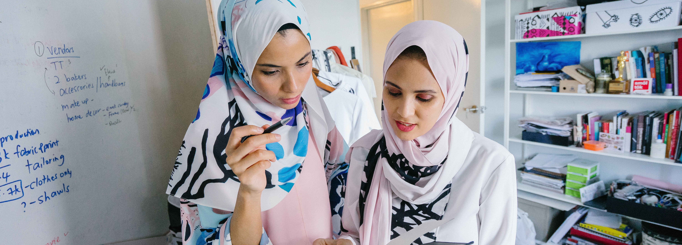
3.0 General Instructions for Trainers & Educators
Methodological Approach
The Open Education Resources consist of a 4 Module Curriculum to introduce learners to the scope and potential of Design for Change in a way that is both rigorous and congruent with academic research and focused on the real-world use of innovation.
The Curriculum is based on the understanding that there are opportunities present, but that Learners and Educators need assistance in the understanding and process of Design Thinking, and how to become Design Thinking Community Change Makers within their communities.
Use of Challenge Based Learning makes this course very engaging. Challenge-Based Learning (CBL) is an innovative pedagogical approach that transforms the learning experience by immersing students in real-world challenges. By addressing genuine problems, students find the learning process to be immediately relevant, fostering increased motivation and engagement. Instead of being passive information recipients, they become active problem solvers, collaborating with peers to derive diverse solutions, and integrating knowledge from various subjects for a holistic understanding. This active engagement, coupled with the intrinsic motivation from making tangible impacts, ensures deeper content retention.
Moreover, CBL emphasizes reflection, allowing students to internalize and apply their learnings in different contexts. The interdisciplinary nature of CBL ensures that beyond content knowledge, students cultivate crucial 21st-century skills such as critical thinking, creativity, and adaptability. As they navigate through challenges, they continually receive feedback, promoting a growth mindset and encouraging continuous improvement.
General Instructions
Please read this guide thoroughly before conducting the training.
For classroom, flipped or blended delivery please:
Download, review and revise course resources for the training as necessary. Allow adequate training time for session.
Localise training content with case studies and information on local supports for your students.
Ensure that each participant completes exercises embedded in each Module – these provide valuable learning.
Allow time for review of exercises and provide a feedback loop.

Slide 14
4.0 Course Delivery Options
Classroom Training & Tools Required
Classroom training remains one of the most popular training techniques for building skills capacity. Typically, it is instructor-centred face-to-face training that takes place in a fixed time and place. We would really encourage that this training is rooted in community-based learning. Impact can be achieved by communities joining together to progress this training – it can augment environmental improvement actions. For such training, we provide …
Classroom Tool | Suggested Use in the Classroom | Additional Resources Required
PowerPoint © presentation | Training materials are developed in PowerPoint. We provide 4 ‘ready-made’ PowerPoint decks that you can adapt to your priorities and circumstances. We suggest that these will be displayed on a large screen for classroom delivery | Laptop/ Computer Projector Large screen / wall
Videos | Videos are used to explain certain sections of the training content and to present case studies for discussion. | Audio / sound system
Whiteboard or Flip Chart | Invite learners to write on the board or ask them for feedback that you write on the board | Pens / markers
Assistive Technology | To increase Accessibility and Inclusivity | Screen readers, hearing aids, or voice recognition tools can aid differently-abled learners. *
Evaluation Surveys | Regularly assess the effectiveness of the training modules and gather feedback for continuous improvement

Slide 15
Course Delivery (continued)
Suggested delivery mechanisms:
Small group discussions: Break the participants down into small groups and give them case studies or work situations to discuss or solve. This allows for knowledge transfer between learners.
Q & A Sessions: Informal question-and-answer sessions are most effective in small groups and for updating skills rather that teaching new skills. These should be used frequently across course delivery.
Multimedia: Multimedia training materials tends to be more proactive and challenging and therefore, more stimulating to the adult mind. Trainers should ensure that all imbedded tools are used to their full potential.
Interactive Tools: The engagement of learners can be easily achieved by using interactive tools. An example of a free tool is Kahoot! Which is a game-based learning and trivia platform used in classrooms, offices, and social settings. You can compline a quiz, which can be answered by the students on their phones/tablets/computers. It is possible to get immediate feedback and results.
Other teaching formats suitable for this course
Flipped Classroom - In a flipped classroom learners study the module content prior to the class with a focus on exercises and assignments in class. The classroom transfer of knowledge make way for online instruction outside the classroom. This creates more room for practicing in class, for extra explanation when needed, and offers the possibility to dive deeper into the materials during class time.
Blended Learning - Combines online digital media with traditional classroom methods. It requires the physical presence of both teacher and learner, with some element of learner control over time, place, path, or pace. Learners attend a classroom setting with a trainer present, face-to-face classroom practices combined with computer-mediated activities regarding content and delivery.
Collaborative/Peer-to-Peer Learning – Is an educational approach to teaching and learning that involves groups of learners working together. An example for boosting collaborative and peer-to-peer learning is Peer review: Peers in the classroom are brought together to jointly evaluate the work by one or more people of similar competence to the producers of the work. Peers not only assess the performance of each other but also share their experiences and know-how.

Slide 16
4.1 What the Modules Cover
The open education resources consist of 4 Modules
to engage and introduce learners to Design Thinking.
Module 1 – Design Thinking: What is it and when to use it?
The first module, will give learners a basic understanding of the Design Thinking process and how to use it to solve challenges in their communities.
Module 2 – Observe, Empathise and Define
The second Module, takes learners through the first two steps of the Design Thinking process. Informing them how to Empathise with their community and Define potential challenges.
Module 3 – Ideate, Prototype & Test
The third module, explores the next three stages in the Design Thinking process. Introducing learners to Ideate a potential solution to the challenges faced, Prototype their idea and then finally Test their solution and see if it benefits the community.
Module 4 – Storytelling and Social Change
The final module, teaches learners the final stage of the Design Thinking process. Taking learners through the process of using Storytelling techniques to promote Social Change within their communities.
Each Module includes dynamic Challenge Activities to encourage learners to use design thinking to solve a challenge.
We now present each module in detail….

Slide 17
A bit about Challenge Based Learning
Challenge Based Learning (CBL) is an educational approach that emphasises problem-solving and real-world application of knowledge and skills.
It is designed to engage students in tackling complex, real life problems or challenges that are often interdisciplinary in nature. It encourages students to collaborate, think critically and apply their learning to address these challenges effectively.
Challenge Based Learning empowers students to become active, engaged learners by addressing real challenges that extend beyond the classroom. It helps them devlop a deeper understanding of the subject matter, while also learning important skills and a sense of responsibility for addressing real-world problems.
Incorporating Challenge Based Learning into Design Thinking, enhances the problem solving and innovation skills of students. While allowing them to engage with real-world challenges in a structured and collaborative manner. This combination prepares students to tackle complex problems creatively, empathetically and effectively.

Slide 18
5.0 Course Content Overview
MODULE 1 | Design Thinking and when to use it
Overview | This module is an introduction to the Design Thinking process, giving learners an overview into each step of Design Thinking, and how it can impact communities for the better.
Learning Objectives | To equipe Adult Learners with the basics of Design Thinking and empower them to becoming Design Thinking Community Change Makers.
Topics Covered | The 6 stages of Design Thinking – Empathy, Define, Ideate, Prototype, Test & Storytelling How to use Design Thinking to bring Social Change Challenge based learning – Using Design Thinking to solve a problem within the community Helpful Resources
Challenge Based Learning Activity | Challenge - Use Design Thinking to solve a challenge in your community. Examples – 1. High rate of littering and pollution in public parks. 2. Lack of affordable & accessible mental health services for low-income residents. 3. High levels of Food waste in Local restaurants. Challenge – Identify a pressing social issue within your community and use Design Thinking to develop a solution.
Resources / Links | YouTube Video – The Design Thinking Process – YouTube Tool – Online White board Miro Download – Design Thinking Bootleg Have a look – Creative Confidence Book by Tom & David Kelly Read this – Field Guide to human centred design Watch – David Kelly talk about Creative Confidence Listen to – The Blend Podcast Article – Reinventing Solar Power with Design Thinking YouTube Video – Building Communities Tool – Empathy Mapping Download – Brainstorming Have a look at - Prototyping Read this – Guide to Co-Design with Design Thinking Watch this – Short film on Storytelling Read this – Article on Impact Evaluations

Slide 19
Course Content Overview
MODULE 2 | Empathy and Define
Overview | This module is an overview of the first and second step in the Design Thinking process. Empathy and Define.
Learning Objectives | Providing learners with the basic understanding of Step 1 and Step 2 in the Design Thinking process. Empathy and Define. Learning ways to observe, understand and emphasise with their community and members, and being able to understand the needs and problems.
Topics Covered | Observing your community using Design Thinking Empathy – what it is and how to use it How to Empathise with a diverse community What it looks like? Challenge based learning exercises How do we understand the needs and problems?
Challenge Based Learning Activity | Challenge – Use observation across Design Thinking. Observe a issue within your community, use design thinking to solve it. Challenge – In the boots of an anthropologist, journalist or sociologist, just for a bit – get to know your community in its entirety. Get to understand the needs of everyone in your community. Challenge – With the arrival of Ukrainian Refugees into your community, how can you identify their needs and problems?
Resources / Links | YouTube video – Observation techniques used in Design Thinking Tool – Empathy Map tool – Miro Have a look – Understanding and Describing the Community Read this – Article on Body Language Download – The Community Engagement Toolkit Watch – Design Thinking for Education: Observation Listen – Want to listen better? Podcast YouTube Video – 1. Design Thinking: Empathise Watch – What is an Empathy Map? Tool – Journey Map Look – Population Grids Download – Rural Stories Toolbox Watch – What is Sociology? Listen – Design Thinking – Co-creation and Empathy YouTube video – Change the way you solve problems Watch – How to define a problem Download – Mural Digital Whiteboard Read – How to use excel Data Visualisation tool? Watch – Design Thinking step 2: Define Listen – Solving problems through Design Thinking Be inspired – Innovating Communities Case Studies

Slide 20
Course Content Overview
MODULE 3 | Ideate, Prototype & Test
Overview | This module is an introduction to the third, forth and fifth steps in the process of Design Thinking. Guiding learners through the ideation phase, how to come up with ideas that will benefit the communities. Then onto the Prototyping phase, and finally onto the Testing phase.
Learning Objectives | Giving learners the basics of the next three stages in the Design Thinking process. Ideation, Prototyping and Testing.
Topics Covered | Ideate towards sustainable equitable solutions Ideation – What it looks like Let’s think about how to ideate towards sustainable equitable solutions Challenge Based Learning Exercise Helpful Resources
Challenge Based Learning Activity | Challenge - Design a system that helps communities reduce their carbon footprint. Challenge – What prototype my community needs? Building a lo-fi prototype. Challenge – Is my idea valid?: Plan a focus group session.
Resources / Links | YouTube video – Design Thinking: Ideate Tool – Jamboard Use – 5 Ways to Improve your creative thinking Review – 9 best exercises to spark creativity in ideation Read this – Design Thinking's exciting third phase: Ideation Watch – 4 simple ways to have a great idea Listen – Ideation Podcast Case Study - Helping People Adopt Sustainable Habits YouTube video – What is Prototyping Tool – Collaborative tools for prototyping online Watch – How team trust inspires innovation Download – Prototyping Framework Toolkit Read – What to look at while Prototyping Watch – Tools for Prototyping Listen – The Future is Ethical YouTube Video – User testing: Why & How Tool – 14 best prototyping tools for designers Review – Usability Evaluation Methods Read – Programme Evaluation Watch – How do focus groups work? Listen – Advancing Community engagement podcast Useful resource – Service Learning & Framework Document

Slide 21
Course Content Overview
MODULE 4 | Storytelling and Kickstarting Social Change
Overview | This Module is about the final stage of the Design Thinking process. Storytelling and how it can be a vital step in kickstarting social change in their communities.
Learning Objectives | To equip Adult Learners with the basics of Storytelling in Design Thinking and empower them to kickstart change in their communities.
Topics Covered | What is Storytelling and when to use it? Let’s think about how Storytelling can bring social change Tips & Hints How to kickstart social change using narratives What is interpretation in the context of Social Change
Challenge Based Learning Activity | Challenge – Use Storytelling to bring Social Change in your community through intergenerational dialogue. Challenge – Develop a counternarrative to deconstruct a narrative that obstructs the social change. Challenge – Understanding Social Change: Interpreting perspectives
Resources / Links | YouTube Video – Introduction to Storytelling Tool – Chat GPT – to transform transcript into engaging stories Download – Audio-Video consent form template Tool – Vimeo – Free video editor Read – The 15 basic phases of a life interview Tool – Audacity – Free audio editor Watch – Life lessons from 100-year-olds Watch – How to use deep narratives Download – Lessons learned from alternative narrative Tool – 5 Steps for Counter-Storytelling Read – Critical Counter-Narrative Tool – Counter Narrative Library Watch - Counter-narratives through storytelling Watch – Social Change: Characteristics of Social Change Tool – Sustainable Development Goals Read – Perspectives on interpreting Read – Finding voice: A visual arts approach to engaging social change Watch – Art of Social Change Listen – Jane Gray on researching Social Change over time

Slide 22
6.0 Sample Timetable
It is recommended to keep workshops to a maximum length of 2.5 – 3 hours. Since the learning materials are quite intense and new to the teachers and learners, it is recommended to spread the information across multiple days. For the best processing, you can choose to spread the workshops across weeks, so for example one evening per week over 6 weeks. Make sure to include field trips, bring in guest speakers and conclude the programme with a celebration.
Week 1: Module 1 – Design Thinking: What is it and when to use it?
Introduction to Design Thinking and its significance.
Understanding the stages of Design Thinking
Real-world examples of Design Thinking in Action
Challenge Activity 1: Use Design Thinking to solve a challenge in your community. (e.g., Littering, Mental Health, Food waste)
Challenge Activity 2: Identify a pressing social issue and develop a solution.
Week 2: Module 2 – Empathise and Define
The role of Empathy in problem-solving
Techniques for Empathising with the community
Defining problem statements based of Empathy findings.
Challenge Activity 1: Use observation across Design Thinking to understand your community.
Challenge Activity 2: Immerse yourself in your community’s needs.
Challenge Activity 3: Address the needs of Ukrainian Refugees through Empathy.
Week 3: Module 3 – Ideate, Prototype & Test
Brainstorming and Idea generation techniques
Selecting ideas and creating initial prototypes
Introduction to Prototyping methods and tools.
Basics of testing and feedback collection
Challenge Activity 1: Design a system to reduce carbon footprint
Challenge Activity 2: Create a low-fidelity Prototype for a community need
Challenge Activity 3: Plan a focus group session for idea validation
Week 4: Module 4 – Storytelling and Social Change
The power of Storytelling in communication
Crafting compelling narratives for Social Change
Leveraging different mediums for Storytelling
Ethical considerations in Storytelling for Social Impact
Challenge Activity 1: Use Storytelling to bring Social Change though intergenerational dialogue
Challenge Activity 2: Develop a counternarrative for deconstructing obstructive narratives
Challenge Activity 3: Gain insights into Social Change by interpreting perspectives
This timetable spans four weeks, dedicating each week to a module along with its corresponding challenge based learning activities. The challenges encourage students to apply their knowledge of Design Thinking concepts into real-world situations, fostering practical skills and promoting community focused problem solving. Please adjust timings and activities as needed to suit your teaching environment.

Slide 23

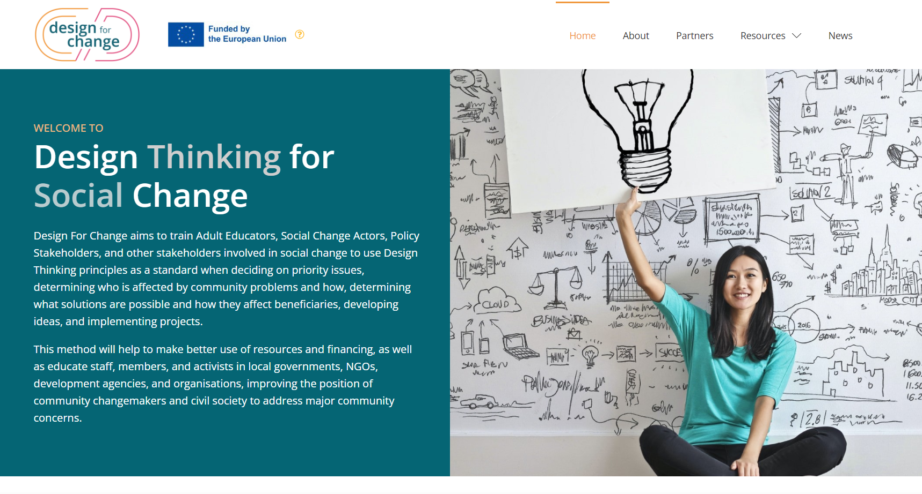

Follow our Journey
Thank you
www.soicalchange.how
follow your journey

