Slide 1


What design thinking is and when to use it
Module 1
The European Commission support for the production of this publication does not constitute an endorsement of the contents which reflects the views only of the authors, and the Commission cannot be held responsible for any use which may be made of the information contained therein.
Project No: 2021 -1 FR01 - KA220 - ADU - 000035257
Design for Change Open Educational Resources © 2023 by Design for Social Change Partnership is licensed under CC BY-SA 4.0

Slide 2

What design thinking is and when to use it?
Design Thinking is a collaborative method for problem-solving. You can use it with other people from your community to solve community issues and create positive change.
Finding the problem to solve, and solving is so that it suits the people is not easy, but with this method it can be done well.

Slide 3
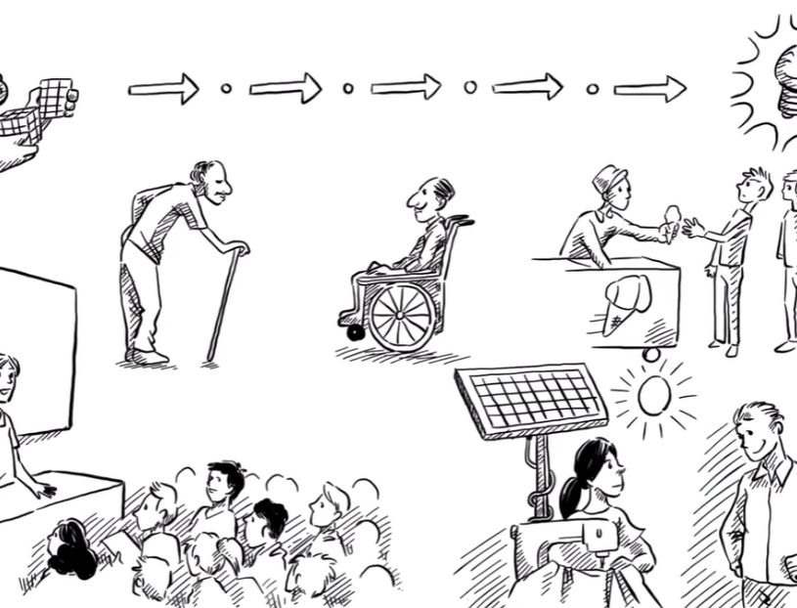
How it looks like?
In this video you can see what Design Thinking is and the 5 steps you take to achieve it.
Click on the right to watch the video.

Slide 4


6 stages of Design Thinking.
Empathise
Ideate
Test
Define
Prototype
Storytelling

Slide 5

Empathise
The first step in Design Thinking is to empathise with the people who have the problem. This involves researching, observing and talking to them to understand their needs and motivations.

Slide 6
Define
Define the problem based on empathy insights by creating a clear and actionable problem statement.

Slide 7

Ideate
The ideation phase involves generating creative solutions to the defined problem through brainstorming and ideation techniques to create a variety of options.

Slide 8
Prototype
The prototype phase is where ideas are transformed into tangible solutions through physical or digital prototypes, sketches or models, allowing for testing and refinement of ideas.

Slide 9
Test
To test prototypes with real users, gathering feedback, iterating, and refining solutions until the final product meets user needs/solves the problem.

Slide 10

Storytelling
Where you communicate the solution to a wider audience using marketing materials, presentations, or case studies. By storytelling, you can create a more engaging and emotional connection with the user, making the solution more memorable and effective.

Slide 11
Let’s think about how to bring social change using design thinking
Why do we need Design Thinking to bring social change?
Why is the change needed?
What is wrong with how we are doing it now?
What is good about this method?

Slide 12
Tips and Hints
Design Thinking for Social Change
What is wrong with how we’re doing it now?
When applied to social problems, design thinking can be used to craft product-service combinations that are intended to create an experience to do away with such issues. In doing so, the social problem is identified as a design problem that could be solved by creating services, models, or experiences.
re-thinkingthefuture.com
Why change is needed
Some of the reasons, our current approach may not be as effective are, lack of user-centred approach, limited collaboration with communities, not enough testing of prototypes and inadequate evaluations.
What is good about this method?
Change is needed to address systemic issues, injustices, and inequalities that exist in society. These can manifest in various forms such as discrimination based on race, gender, or socio-economic status, environmental degradation, and political corruption, among others.
Design thinking provides a structured and effective framework for problem-solving that emphasises user needs, creativity, collaboration, and continuous improvement. Meaning you get the best results to benefit everyone.
Title One
Title Three

Slide 13
CHALLENGE
We understand there are many challenges in communities, and they may vary between places. Here are a couple of challenge examples you can try and solve in your community.

Slide 14
The callenge
Let’s dig deeper
Use Design Thinking to solve a problem in your community
Remember, this is just an exercise and you do not have to spend days working on this. The goal here is that you get the feeling of what design thinking is and how you can use it to create a better community for you and your neighbors, friends, colleagues, and peers.
Task 1
Task 2
Find at least 2 peers to form your ‘community’
Learn the Design Thinking approach and investigate your community
Task 3
Choose a challenge. From the examples. Or one your community has experienced.
Task 4
Using the Design Thinking approach try to solve your ‘communities' challenge

Slide 15
Community Example Challenge 1:
High rate of littering and pollution in public parks
Using the Design Thinking approach try to solve the following challenge.
Make sure to use the 6 steps of Design Thinking.
Empathise | Define | Ideate | Prototype | Test | Storytelling
Or please feel free to solve a challenge from your own community.

Slide 16
Community Example Challenge 2:
Lack of affordable & accessible mental health services for low-income residents
Using the Design Thinking approach try to solve the following challenge.
Make sure to use the 6 steps of Design Thinking.
Empathise | Define | Ideate | Prototype | Test | Storytelling
Or please feel free to solve a challenge from your own community.

Slide 17
Community Example Challenge 3:
High levels of food waste in local restaurants
Using the Design Thinking approach try to solve the following challenge.
Make sure to use the 6 steps of Design Thinking.
Empathise | Define | Ideate | Prototype | Test | Storytelling
Or please feel free to solve a challenge from your own community.

Slide 18








Here are some resources you can use
Use this tool
Read this
Miro is an online whiteboard where you and your community can share ideas with each other and be more inclusive & collaborative.
The Field Guide provides tools to understand users, brainstorm effectively, prototype ideas, and arrive at creative solutions.
Download this
Watch this
Design Thinking Bootleg - A collection of tools and methods for design thinking
Watch David Kelley talk about Creative Confidence in this TED Talk.
Have a look
Listen to this
Creative Confidence - The book explores the concept of creative confidence, which refers to the belief in one's ability to create and innovate.
The Blend Podcast: Design Thinking Case study.

Slide 19
It is time to write down what did you learn?
In one sentence please summarise what did you learn?
______________________________________________________________________________________________________________________________________
Do you feel confident you’ll be able to solve most challenges in your community, and what needs to happen?
______________________________________________________________________________________________________________________________________

Slide 20

Get inspired
Click the link and read the story of how people seen a problem and solved it with the steps of Design Thinking.
Reinventing solar energy – Supply for rural Africa.

Slide 21
Why design thinking for the greater good and social change.
Learning through a challenge

Slide 22
Design Thinking for the Greater Good.
Design Thinking for the Greater Good goes in depth on both the how of using new tools and the why.
As a way to reframe problems, ideate solutions, and iterate toward better answers, design thinking is already well established in the commercial world.

Slide 23
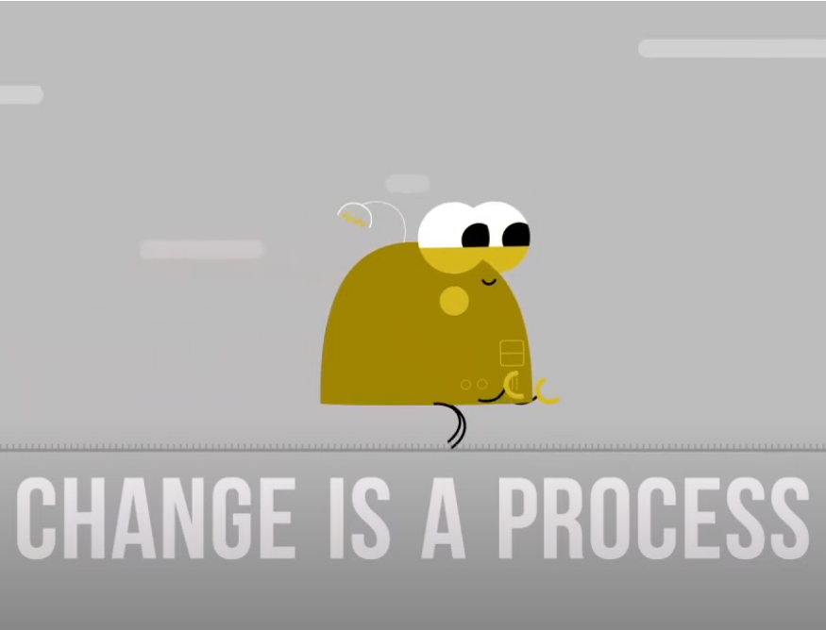
How it looks like?
Click on the right to see a short video of using Design Thinking to build communities.

Slide 24
Let’s think about how to bring social change using design thinking
What social issues in your community can Design Thinking address?
How to involve community members in Design Thinking for inclusive solutions?
How to collaborate for structural change using Design Thinking?
How to measure success of Design Thinking for sustainable social change?

Slide 25
Tips and Hints
What social issues in your community can Design Thinking address?
How to collaborate for structural change using Design Thinking?
To identify the most pressing social issues facing your community, you can engage in community listening sessions, conduct surveys or focus groups, or review existing data on social and economic indicators.
Collaborate with local organisations, institutions and policymakers for structural change through partnerships and policy advocacy. Use Design Thinking to prioritise community needs and develop innovative models
How to involve community members in Design Thinking for inclusive solutions?
How to measure success of Design Thinking for sustainable social change?
Through co-design sessions and workshops to share perspectives and ideas. Ensure inclusive decision-making by forming community advisory committees.
Measure Design Thinking success with quantitative and qualitative metrics, including impact assessments and iterative testing. For example, conducting surveys, community feedback meetings etc.
Title One
Title Three

Slide 26
CHALLENGE
Identify a pressing social issue in your community and use design thinking to develop a solution that creates meaningful and sustainable social change.

Slide 27
The callenge
Let’s dig deeper
Identify a pressing social issue in your community and use design thinking to develop a solution
Task 1
Research into your community to identify the main social issues.
Remember, this is just an exercise and you do not have to spend days working on this. The goal here is that you get the feeling of what design thinking is and how you can use it to create a better community for you and your neighbors, friends, colleagues, and peers.
Task 2
Brainstorm using the design thinking approach to come up with solutions for the issue.
Task 3
Choose a solution to implement and create a plan for how to put it into action.
Task 4
Measure success using both quantitative and qualitative metrics.
Task 5
Reflect on the design thinking process and how it helped you create a solution.

Slide 28

Here are some resources you can use
Use this tool
Read this
Empathy Mapping: Tool for understanding audience perspectives through visual representation of thoughts and emotions.
Guide to Co-Design with design thinking. Getting everyone involved to get the best solutions.
Download this
Watch this
Brainstorming: There are many simple brainstorming sites out there like Miro but you can always use a pen and some post it notes.
Short film on how useful Storytelling within design thinking is. As it helps you get your ideas across at a more human level.
Analyse this
Read this
Prototyping: A guide to Prototyping with the use of Design Thinking.
Article on Impact evaluations. To help you see if your idea is solving the problem or not.

Slide 29
It is time to write down what did you learn?
In one sentence please summarise what did you learn?
______________________________________________________________________________________________________________________________________
Do you now know what will solve your challenge, and what needs to happen?
______________________________________________________________________________________________________________________________________

Slide 30
Now that you know what to do, let’s plan how to do it. Time to ACT!
On the next slide, there is space for you to get all your thoughts down on paper.
Think of a challenge or challenges within your community, write it in the middle circle and work out how to solve it using design thinking.
STEP 3: _________________________________________________________________________
STEP 2: _________________________________________________________________________
Title One
Title Two
Title Three
Title Four

Slide 31
Define
Act
Challenge
Test
Result

Slide 32
Congratulations!
You have solved the challenge

