Slide 1
Observe the Community using Design Thinking
MODULE TWO
The European Commission support for the production of this publication does not constitute an endorsement of the contents which reflects the views only of the authors, and the Commission cannot be held responsible for any use which may be made of the information contained therein.
Project No: 2021 -1 FR01 - KA220 - ADU - 000035257
Design for Change Open Educational Resources © 2023 by Design for Social Change Partnership is licensed under CC BY-SA 4.0

Slide 2
The Power of Observation
In the context of this course, to observe is to watch carefully the way something happens or the way someone does something in order to learn more about it. To observe means to notice or view something, with attention to detail. Observation can be a way to gather information that can lead to understanding.
For example, scientists observe the world around them in order to learn more about it and gain a better understanding.

Slide 3
Observing the Community
Using Design Thinking is a great way to observe anything, especially your community.
You adopt a human-centred approach to understand the community's needs, problems and aspirations.

Slide 4
Using Empathy to Observe
Empathy involves, you putting yourself in someone else’s shoes, to gain the understanding of their needs, challenges, and goals.
When observing using empathy, you are striving to truly understand the experiences and challenges your community faces.
You will gain vital insights into the community, giving you the stepping stones to develop effective solutions that address the issues of the community.

Slide 5
When observing your community, you should:
Actively Listen: Pay attention to what they are saying, their body language and tone of voice. Try not to interrupt.
Be Openminded: Forget about your own experiences or thoughts that might hinder you from truly understanding your community.
Ask Open Questions: Ask questions that encourage your community to share their experiences and thoughts.
Avoid Judgement: It’s important not to judge when observing your community, everyone has a story and an opinion, it is for you to listen.
Role Reversal: Imagine yourself in their position, how would you feel?, how would you tackle the challenges?

Slide 6
How to empathise with a diverse community
1.Be generous with your time as you help others.
2. Spend time with people different from you.
3.Find similarities/common interests with others.
4, Identify and challenge your own prejudices and biases.
5. Spend more time with your community.
6. Teach someone a new skill.
7. Volunteer service to a disadvantaged individual or group.
8. Ask someone to tell you their life story.

Slide 7
What it looks like?
In this example of Observation in Design Thinking, we learn some tips on how to use it effectively.
Click on the image on the right to watch, or access via https://youtu.be/kkhoq6Hq12M

Slide 8
Defining your Observations
After you have used empathy to Observe your community, you will then need to use the observations you have gathered to define the core problems and opportunities you aim to address.
Review your observations and stories gathered, look for recurring themes, emotions and challenges. This will give you a proper indication of what is the most pressing challenge within your community.

Slide 9
Ideating your Observations
Ideation is a structured process of guiding the right people through a number of carefully designed exercises to come up with innovative ideas.
Gather a diverse group of your community members, designers, experts, and others who can contribute creative ideas. The question #Whatif is very powerful.
Brainstorm and generate a wide range of ideas to address the defined challenges.
Encourage an open and non-judgmental atmosphere where all ideas are welcomed.
10 TOOLS TO ASSIST: Our favorite Ideation tools - Board of Innovation

Slide 10
Some Strategies/Ideas:
Observe, Ask, and Listen, listen, listen. Engage the community in recording their own stories and images, using tools like Photovoice. Think of this from the beginning as a shared process
Build a shared community map to identify potential needs and assets. Example
Attend Local Council Meetings and jot down issues being discussed during the open forums, or host community fun events where you are also cultivating participation.
Look for community organized events via Meetup | Find Local Groups, Events, and Activities Near You
Attend local NGO fairs and Outreach events
Learn as much as you can, noticing your own assumptions and biases.
Read more on How Design Thinking Transforms Communities, One Project at a Time | Getting Smart

Slide 11
Prototype your Ideas
Innovation relies on a concept called ‘rapid prototyping.’ In this phase of the design process, people constructed models of their solutions using whatever materials were available. Select a few of the most promising ideas generated during the ideation phase and create simple prototypes.
These could be sketches, mock-ups, or simple models that represent your potential solutions. Prototypes are meant to be quick and cost-effective ways to test your ideas without fully committing resources.

Slide 12
Observing your Testing
Put your prototypes in front of the community members and gather feedback.
Observe how they interact with the prototypes and listen to their thoughts and reactions.
This feedback loop helps refine and improve the solutions based on real-world user input.

Slide 13
Let’s think about how to observe a diverse community
Research and Preparation
Engagement and Immersion
Reflection
Active Observation

Slide 14
Tips and Hints
Research and Preparation
Active Observation
Engagement and Immersion
Reflection
Engage in conversations with your community to understand their experiences. Listen attentively and ask open questions. Pay attention to body language, facial expressions, and gestures to gain insights into emotions.
Gathering basic information about the community's culture, history, demographics, and any specifics that might impact your observations. Can be done through, interviews, surveys etc.
Taking notes and recording your findings is essential to develop effective solutions. Capturing both facts and personal reflections.
After observing, take time to analyse your notes and reflect on the cultural context, behaviours and insights.
Build relationships by connecting with your community members, leaders, and local businesses owners, they will give you great insights or be able to introduce you to others. Attend community events or gatherings, immerse yourself.
Title One
Title Three

Slide 15
CHALLENGES
Engaging and maintaining community involvement.
Overcoming differences between and among academics and the community.
Working with nontraditional communities.
Initiating a project with a community and developing a community advisory.
Overcoming competing priorities and institutional differences.

Slide 16
The challenge
Task 1
Let’s dig deeper
Use Observation across Design Thinking
Work in pairs to observe real-world communities.
Remember, this is just an exercise and you do not have to spend days working on this.
The goal here is that you get the feeling of what design thinking is and how you can use it to create a better community for you and your neighbours, friends, colleagues, and peers.
Task 2
Task 3
Brainstorm solutions while using your observation insights. Come up with ideas that benefit community needs.
Collect data, photos and notes that capture the community’s needs, challenges and emotions.
Task 4
Task 5
Create a Prototype based on your observations and community needs.
Test your prototype, highlighting how your observation has influenced each phase of Design Thinking.

Slide 17
Here are some great resources you can use
Download this toolkit
Use this tool
The Community Engagement section of the Community Planning Toolkit. Gives you insights on how to engage your community. Focusing on quality and effectiveness.
Empathy map: this tool is used to build a shared understanding of the user's needs and provide context to a user-centred solution
Have a look
Watch this
This article about Understanding and Describing the Community.
Design Thinking for Education: Observation
Read this
Article on Body Language, What it is and how to read it.
Listen to this
Want to Listen better? Turn down your thoughts and tune into others podcast

Slide 18
It is time to write down what did you learn?
In one sentence please summarise what did you learn?
______________________________________________________________________________________________________________________________________
Do you now know what will solve your challenge, and what needs to happen?
______________________________________________________________________________________________________________________________________

Slide 19
Empathise with diverse community
Learning through a challenge

Slide 20
Empathy
Design thinking includes different main steps.
The first step is Empathy.
Empathy consists in getting to know the humans for who solutions are made.
Understanding needs, feelings and pinpoints of a given population.

Slide 21
How to Empathise with Diverse Community
In this module we will focus on diverse community.
By diverse community we consider people coming of different social background, age, gender, race, culture, habits, religion, point of views etc.
This module will support learners in knowing how to empathise with diverse community through tools.
Diversity can be the key to have a comprehensive approach to find solutions that answers common needs.

Slide 22
How it looks like?
In this example you can see an introduction on Empathy, an important first step.
Click on the right to watch the video
”Dropping assumptions” is an essential ingredient regarding diverse community. The less bias you have the better.

Slide 23
CHALLENGE
In the boots of an anthropologist, journalist or sociologist, just for a bit – get to know your community in its entirety!

Slide 24
Let’s think about how to empathise with a diverse community
How can I find existing information on my community ?
How can I understand better how my community behave daily?
How can I acknowledge their feelings ?
Do I have enough information to represent the situation?

Slide 25
Tips and Hints
Desk Research
Qualitative data
Check and improve
Research is important to gather existing data on your community. You can create a set of articles, videos that will help you to know them better.
Go to the city hall, public library or local newspaper .
Always verify your sources!
Quantitative data
Observations and interviews will support a full immersion with the community. This can be completed with empathy maps.
Empathy maps will be develop next.
To assess that your are on the right path, ask yourself the good questions: is the group representative to answer the needs?
-Use data on gender or age
-Make sure that it fits with reality.
Figures are always a good help to understand habits and can be fo und through interviews: how many time do they go to the cultural center ? How much time to they spend at local business?
A journey map can be done! See example next.
Title One
Title Three

Slide 26
Get to understand the needs of everyone in your community
Let’s dig deeper
The challenge
Remember, this is just an exercise and you do not have to spend days working on this. The goal here is that you get the feeling of what design thinking is and how you can use it to create a better community for you and your neighbors, friends, colleagues, and peers.
Task 2
Task 1
Make research on demographics figures of your community and create a grid of ”main groups represented”. (age, gender, profesions for eg)
Find an article from the last 5 years about your community’s diversity and synthetize it in 1000 caracters.
Task 3
Task 4
Prepare an interview of 8 questions on their habits and feelings.
Find 3 persons from different background to interview.

Slide 27
Here are some resources you can use
Download this toolkit
Use this tool
The Rural Stories toolbox is a set of 11 step-by-step training kits that allows you to learn about mobile journalism (MoJo), kit n°4 is on Organizing your Immersion in the field and how to prepare a good interview
Empathy map: this tool is used to build a shared understanding of the user's needs and provide context to a user-centered solution
Use this
Watch this
Journey map: is a visualization of the process that a person goes through in order to accomplish a goal
What is sociology?
https://www.youtube.com/watch?v=YnCJU6PaCio
Look at this
Population grid statistics for demographics figures
Listen to this
Podcast on how to co-create through empathy

Slide 28
III. It is time for you to ACT
THIS IS YOUR LAST STEP TO SOLVING THE CHALLENGE
It is time to create your own materials:
A summary of an article
A demographics document
A journey and empathy map
An interview

Slide 29
CHALLENGE#1:Find an article from the last 5 years about your community’s diversity and synthetize it in 1000 caracters.
Check and give the source : name of author, date of publication
State the main ideas.
Give figures
Identify the most important details that support the main ideas.
Summarize in your own words.
Do not copy phrases or sentences unless they are being used as direct quotations.
Express the underlying meaning of the article, but do not critique or analyze.
The summary should be about one third the length of the original article.

Slide 30
CHALLENGE#2:Make research on demographics figures of your community and create a grid of ”main groups represented”. (age, gender, social background) and check if your group is diverse.for eg)
Exemple of grid
AGE | GENDER | SOCIAL BACKGROUND | SOCIO PROFESIONAL CATEGORY
0–14 years old | FEMALE | Low income | STUDENT
15–47 years old | MALE | Middle income | WORKER
48–63 years old | NON-DEFINED* | High income | RETIRED
≥ 64 years old | *it’s important to have opened categories depending on the topic | *People can self-assess or you can fix some income criterias | UNEMPLOYED

Slide 31
CHALLENGE#3:Prepare an interview of 8 questions on their habits and feelings.
Ideas of typical questions for an interview
HABITS | FEELINGS | FUTURE
1. With who | 1. What do you think of xxxxx | 1. How do you think this will evolve ?
2. When | 2. What word would you use to describe the feeling ? | 2. Would you like this to change in the future ?
3. What action …. | 3.What worries you ? | 3. What could we do to have a new situation?
4. Where | 4. What is exciting for you about xxxx? | 4. Would you be willing to be a change-maker?
5. Why do you make this choice? | 5. Who do you trust on this topic? | 5.What’s the next step that should be done?

Slide 32
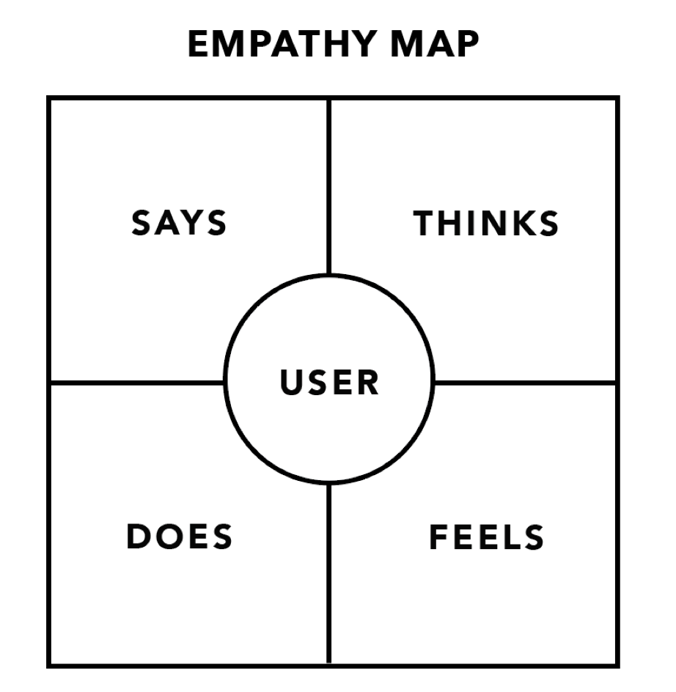

Slide 33
CHALLENGE#4: Find 3 persons from different background to interview.
Ideas to find the right persons
WHERE TO FIND THEM | CRITERIAS | APPROACH
Local organizations | Motivation | Flexibility : be available and flexible to their schedule
Social media | Benevolence/Kindness | Openmindness: Adapt your questions
Sports club | Representative of the population | Ambassadors: ask them if they know other people who can help you with your research
Local events | Availability | Don’t hesitate to make them repeat or precise their statement

Slide 34
It is time to write down what did you learn?
In one sentence please summarise what did you learn?
______________________________________________________________________________________________________________________________________
Do you now know what will solve your challenge, and what needs to happen?
______________________________________________________________________________________________________________________________________

Slide 35
Understanding the
needs and problems
Learning through a challenge

Slide 36
How do we understand the needs and problems?
Definition is the second phase of
Design thinking.
The needs and problems faced or
experienced by the community will
be diverse depending on the make up
of the community and based on who
is participating in the community. It
is during this stage that the needs
and problems are clearly identified and stated.

Slide 37
How it looks like?
In this example you can see Design
Thinking can help individuals and communities get to the root of the real problem
Design Thinking puts People First!
The closer we stay to the people we
want to help, the better we will
understand the real problem
Click on the right to watch the video.

Slide 38
Let’s think about how we can clearly define needs and problems
Do we have enough information to analyse and complete a “User needs statements” ?
Who are the community members we need to meet to discuss their needs?
What methods will we use to identify the needs?
How will we record their inputs?

Slide 39
Tips and Hints
Engagement
Recording Data
Develop strong communication channels with the community using social media, traditional media, and existing contacts with community groups to encourage participation
To ensure you are getting to the heart of the needs and problem it is really important to have a robust system for recording the content from the participants, ensure you have flipchart, markers, post-its etc.
Methods
Definition
Once you have community members committed to participating you could use focus groups and workshops to gather the information on the problem
Compile all the information gleaned to try and identify a clear need/ problem using a “User Needs Statement”
Title One
Title Three

Slide 40
CHALLENGE
With the arrival of Ukrainian Refugees into your community, how can you identify their needs and problems?

Slide 41
The challenge
Let’s dig deeper
With the arrival of Ukrainian Refugees into your community, how can you identify their needs and the problems they face?
Task 1
Identify how you will reach and engage with Ukrainian Refugees and supports in your community?
Remember, this is just an
exercise and you do not have to
spend days working on this. The
goal here is to better
understand the
Problem-Solving/ Definition
stage of Design thinking,
providing you with help on how
to define a need or a problem
clearly.
Task 2
Task 3
Develop questions for a focus group to help you clearly identify the need
Invite at least 15 Ukrainian refugees to a focus group/ workshop and facilitate the process to identify the need
Task 4
Analyse the data and use
Data Visualisation Tools to
Present the information gleaned on the problem

Slide 42
Here are some resources you can use
Read this
This provides information on using Data Visualisation Tools
https://chartexpo.com/blog/excel-data-visualization-tool#
Use this tool
Canva is a good tool for creating a problem or user statement
https://www.youtube.com/watch?v=w7l8qEj1JX0
Watch this
This is a user-friendly video on this phase
https://www.youtube.com/watch?v=4AHO42Aq5fM
Download this
Mural is an intuitive digital whiteboard to allow groups to collaborate to solve problems
https://mural.co/
Listen to this
Podcast which outlines a real company who used design thinking to solve a problem
https://podcasts.apple.com/us/podcast/ep-33-solving-problems-through-design-thinking/id1528395292?i=1000516698648

Slide 43
It is time to write down what did you learn?
In one sentence please summarise what did you learn about defining a problem?
______________________________________________________________________________________________________________________________________
Are you aware of the methods you can use to engage with individuals to better
identify their needs?
______________________________________________________________________________________________________________________________________

Slide 44
Get inspired
Check out these case studies to learn more
https://www.innovating.ie/design-thinking

Slide 45
Now that you know what to do, let’s plan how to do it. Time to ACT!
On the next slide, there is space for you to get all your thoughts down on paper.
Think of a challenge or challenges within your community, write it in the middle circle and work out how to solve it using design thinking.
STEP 3: _________________________________________________________________________
STEP 2: _________________________________________________________________________
Title One
Title Two
Title Three
Title Four

Slide 46
Define
Act
Challenge
Test
Result

Slide 47
Congratulations!
You have solved the challenge

