Slide 1


Ideate towards sustainable equitable solutions
Module 3
The European Commission support for the production of this publication does not constitute an endorsement of the contents which reflects the views only of the authors, and the Commission cannot be held responsible for any use which may be made of the information contained therein.
Project No: 2021 -1 FR01 - KA220 - ADU - 000035257
Design for Change Open Educational Resources © 2023 by Design for Social Change Partnership is licensed under CC BY-SA 4.0

Slide 2

Ideate towards sustainable equitable solutions
Ideation is the third stage in the Design Thinking process, where the goal is to generate a wide range of ideas and potential solutions to a problem. In this stage, the team employs various techniques such as brainstorming, mind mapping, sketching, and prototyping to explore and create innovative and effective solutions.

Slide 3

Ideation
The ideation phase represents a key in-between step from learning about your users and the problem they are having, to producing solutions. In the ideation phase this is where innovation can thrive! By practicing ideation with a diverse team, we can leverage the unique perspectives and backgrounds of each member to create equitable solutions that address common needs.

Slide 4
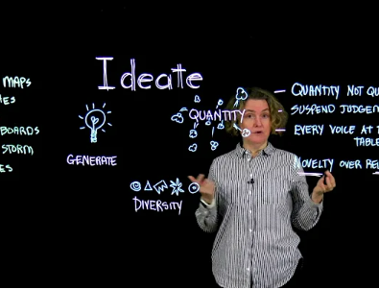
How it looks like?
In this example you can see an overview of what the ideation stage is…
Click on here to watch the video

Slide 5
Let’s think about how to ideate towards sustainable equitable solutions
How do you think a diverse team can contribute to the ideation stage of design thinking in addressing social issues?
In your opinion, what role does empathy play in the ideation stage of design thinking when addressing social issues?
What is beneficial about the Ideation method?
What are some social issues that you think could benefit from the ideation stage of design thinking?

Slide 6
Tips and Hints
Research
Empathy and Ideation
Research is important to identify social issues that could benefit from design thinking. You can create articles or videos, or visit city hall, the public library, or local newspapers. Verify your sources. Social issues that could benefit from ideation include poverty, education inequality, mental health, and homelessness.
To incorporate empathy into the ideation stage of design thinking, learners should actively listen, observe, and conduct research to gain a deeper understanding of the community's culture, values, and beliefs. Remaining curious and open-minded about the community's experiences and perspectives can help challenge assumptions and biases, leading to more innovative solutions.
A Diverse Team
Benefits
A diverse team is crucial to the ideation stage of design thinking for social issues. They bring different perspectives, challenge assumptions, and identify overlooked issues. Seek out team members from diverse backgrounds to ensure all perspectives are considered during ideation.
The Ideation method is beneficial because it encourages creativity, innovation, and a diversity of ideas, which are crucial in developing effective solutions for complex social issues. It also helps refine ideas through prototyping and testing.
Title One
Title Three

Slide 7
CHALLENGE
Design a system that helps communities reduce their carbon footprint

Slide 8
The challenge
Task 1
Let’s dig deeper
Design a system that helps communities reduce their carbon footprint
Find at least 2 peers to collaborate with
Remember, this is just an exercise and you do not have to spend days working on this. The goal here is that you get the feeling of what design thinking is and how you can use it to create a better community for you and your neighbors, friends, colleagues, and peers.
Task 2
Define the problem and identify the key stakeholders
Task 3
Task 4
Generate a wide range of potential solutions using brainstorming techniques
Evaluate and prioritise solutions based on their feasibility, impact, and equity

Slide 9





Here are some resources you can use
Read this
Use this Tool
Design Thinking’s Exciting Third Phase: IDEATING. For a better idea on Ideation
Online Mind-mapping tool - Jamboard
Read this
Watch this
Article for if you are struggling with creativity. 5 ways to Improve your Creative Thinking
4 simple ways to have a great idea | Richard St. John
Review this
Listen to this
Review these techniques that can help you with the ideation stage – 9 best exercises to spark creativity in ideation
Many great podcasts about Ideation

Slide 10
It is time for you to ACT
THIS IS YOUR SECOND STEP TO SOLVING THE CHALLENGE
It is time to create your own materials:
A report on the problem
A demographics document on the key stakeholders
A mind map of possible solutions
A report on sustainable, equitable & feasible solutions

Slide 11
It is time to write down what did you learn?
In one sentence please summarise what did you learn?
______________________________________________________________________________________________________________________________________
Do you now know what will solve your challenge, and what needs to happen?
______________________________________________________________________________________________________________________________________

Slide 12
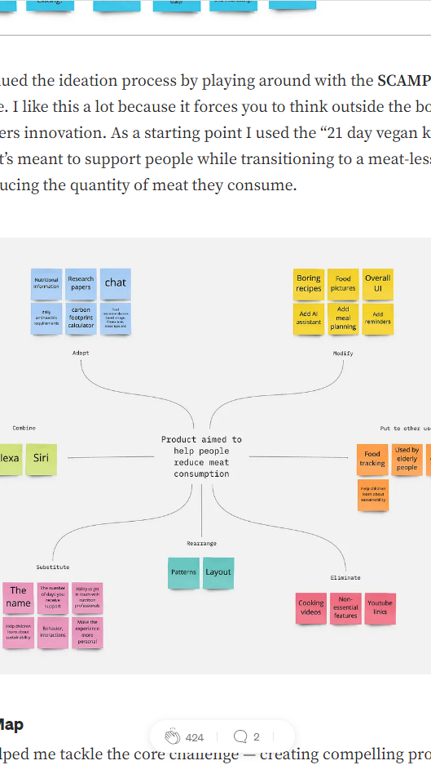
Get inspired
UX case study: Helping People Adopt Sustainable Habits
https://uxplanet.org/ux-case-study-helping-people-adopt-sustainable-habits-3e659d422b37
Case study overview
Challenge: Help people reduce or replace meat from their diets.
Goal: Reduce the carbon footprint in order to help our planet.
Why choose this challenge: Food is a major contributor to carbon footprints, and meat is an issue. Livestock is responsible for a significant amount of greenhouse gas emissions, and beef is one of the biggest contributors. Last year, the medical journal The Lancet reported that global consumption of red meat needs to fall by 50 percent by 2050 for us to “remain within a safe operating space” on climate change. And in 2018, the journal Nature reported that beef consumption in Western countries needs to fall by 90 percent.
Tools: Sketch, Miro, Zoom, Invision, ProtoPie

Slide 13
Prototype for better future
Learning through a challenge

Slide 14
What is a prototype?
Let´s make a difference between the process of prototyping and, the result: the prototype.
A prototype is an example materialised of the idea you produced. While prototyping involves a process of synthesizing and building up your idea.

Slide 15

How it looks like?
In this video, you can explore further what is prototyping and how the process looks like
“They slow us down to speed us up. By taking the time to prototype our ideas, we avoid costly mistakes such as becoming too complex too early and sticking with a weak idea for too long.”
— Tim Brown, CEO & President of IDEO

Slide 16
Let’s think about how prototype to bring social change using design thinking
Why prototype?
How to do it?
When to do it?
What data you will measure?

Slide 17
Tips and Hints
Why prototype?
When to do it?
Design thinking is a non-linear process, while there is a step-by-step methodology (Design-Ideate-Prototype-Test) prototyping can be conducted at the early stages of the project to ensure the validation of ideas.
By creating a prototype, you can hold a version of your proposed product and determine what aspects do its job and which ones need refining. – Essentracomponents
How to do it?
What data should you measure?
You can start with lo-fi prototypes. A lo-fi prototype is a basic sketch where you conceptualise the main idea. Take a look at the difference between lo-fi vs high-fi.
3 main aspects to evaluate:
The usefulness of your idea.
Utility for your target group.
The costs associated.
Title One
Title Three

Slide 18
CHALLENGE
What prototype my community needs?

Slide 19
Let’s dig deeper
The challenge
Building a lo-fi prototype
Your community needs to feel engaged with your idea. A great way of engaging them is to create a common space for ¨collaborative prototyping¨. The goal here is that you get the feeling of what prototyping is and how you can use it to create a better community for you and your neighbors, friends, colleagues, and peers.
Task 1
Find at least 2 peers to collaborate with or stakeholders of your community
Task 2
Task 3
Set a timeline to create a lo-fi prototype based on the needs of your community.
Present the prototype to your community and gather information about what they think about it.

Slide 20


Here are some resources you can use
Use this tool if…
Read this
If you feel like it’s difficult to engage your community on-site. Here you have some collaborative tools for prototyping online
What to look at while prototyping?
Download this if…
Watch this
You´re not sure how to start prototyping. (download toolkit)
Bill Burnett and Dave Evans share tools for prototyping and iterating your way to a better future in this video.
Review this if...
Listen to this
Feeling overwhelmed about group dynamics. Take a look at this!
Is the future ethical?

Slide 21
It is time for you to ACT!
THIS IS YOUR FIRST STEP TO SOLVING THE CHALLENGE
Now is the time to prototype the idea that you´ve previously ideated. A couple of things to manage here are:
Establish a timeline and a place for your prototyping sessions.
Contact your target group and stakeholders
Document all the information (you may need some material resources: post-its, notebooks, flip-charts,etc.)

Slide 22
It is time for you to ACT!
THIS IS YOUR FIRST STEP TO SOLVING THE CHALLENGE
Documenting all the information may serve a two fold objective: 1. Backup your insights, 2. Actively disseminate your idea. Think about the following:
1. What will you document?
2. How will you do it?
3. Where will do it?

Slide 23
It is time to write down what did you learn?
In one sentence please summarise what did you learn?
______________________________________________________________________________________________________________________________________
Do you now know how will you prototype, and what needs to happen?
______________________________________________________________________________________________________________________________________

Slide 24

Still not sure where to start?
Review our section 4 of Design Thinking for Social Change Guide

Slide 25

Get inspired
Paper prototyping is a core tool in the design of mobile phone user experiences.
Paper prototyping provides a tool for everyone to take part in the design process. It enables collaboration and consideration of a design solution from multiple perspectives.

Slide 26
Testing your solution
Learning through a challenge

Slide 27
What is testing?
Once your prototype is ready, the next step is to test it. There are many different forms to test your prototype and, in this module, you will see some techniques.
The most important thing about testing is to gather feedback from your users in order to find mistakes and improve our solution.

Slide 28

How it looks like?
In this video, you can explore further what is testing and how the process looks like
Supposing is good, but finding out is better— Mark Twain

Slide 29
Testing to bring social change
Why testing?
How to do it?
When to do it?
What data you will measure?

Slide 30
Tips and Hints
Why testing?
When to do it?
Design thinking is a non-linear process, and while there is a step-by-step methodology (Design-Ideate-Prototype-Test) testing can be conducted at the early stages of the project to ensure the validation of ideas.
Testing means evaluating the ideas created and gathering the information to improve our product/service. If we don’t test, our solutions may not be adapted to the reality of our users.
How to do it?
What data should you gather?
There are several techniques and methods to test your solution. Look at the following link to choose the best technique that fits your budget/time.
3 main aspects:
Utility and needs covered.
Feedback from our users.
Body language and reactions.
Title One
Title Three

Slide 31
CHALLENGE
Is my idea valid?

Slide 32
Let’s dig deeper
The callenge
Plan a focus group session
Your community needs to feel engaged with your idea. A great way of engaging them is to create a focus group session. The goal here is that you get your users and explain to them your idea and how your idea will change your community.
Task 1
Find at least 5 end-users.
Task 2
Task 3
Present the prototype to your community and gather information about what they think about it.
Plan your session and set a timeline for the focus group.

Slide 33

Here are some resources you can use
Use this tool if…
Read this
If you feel like it’s difficult to engage your community on-site. Here you have some collaborative tolos.
Program evaluation will give you a better overview of how to assess your work in the community.
Download this if…
Watch this
Feeling overwhelmed about group dynamics. Take a look at this!
How to conduct focus groups?
Review this if...
Listen to this
You´re not sure what method you should use. (https://www.usabilityhome.com/)
To explore more about community engagement:
Bojana Culum Ilic: Advancing community engagement

Slide 34
It is time to write down what did you learn?
In one sentence please summarise what did you learn?
______________________________________________________________________________________________________________________________________
Do you now know how will you test, and what needs to happen?
______________________________________________________________________________________________________________________________________

Slide 35
Still not sure where to start?
Review our section 5 of Design Thinking for Social Change Guide

Slide 36
Get inspired
Why is service-learning so important in Universities?
An example of how universities have combined:
1. Academic learning
2. Community Service
3.Reflexive practices.
For further information:
Framework document for Service-learning program

Slide 37
Now that you know what to do, let’s plan how to do it. Time to ACT!
On the next slide, there is space for you to get all your thoughts down on paper.
Think of a challenge or challenges within your community, write it in the middle circle and work out how to solve it using design thinking.
STEP 3: _________________________________________________________________________
STEP 2: _________________________________________________________________________
Title One
Title Two
Title Three
Title Four

Slide 38
Define
Act
Challenge
Test
Result

Slide 39
Congratulations!
You have solved the challenge

