Slide 1


Storytelling for Social Change Solutions
Module 4
The European Commission support for the production of this publication does not constitute an endorsement of the contents which reflects the views only of the authors, and the Commission cannot be held responsible for any use which may be made of the information contained therein.
Project No: 2021 -1 FR01 - KA220 - ADU - 000035257
Design for Change Open Educational Resources © 2023 by Design for Social Change Partnership is licensed under CC BY-SA 4.0

Slide 2

What Storytelling is and when to use it?
Storytelling is the art of telling stories using a narrative approach.
Through this module you will learn how to use storytelling techniques for promoting social change

Slide 3

How it looks like?
In this video you have a short introduction of storytelling and the essential elements that compose it
Click on the right to watch the video

Slide 4
Let’s think about how storytelling can bring social change
Where can I find the right story to tell?
What are the fundamental features my story must have?
What tool can I use to create an engaging story?
How my story can bring the social change?

Slide 5
Tips and Hints
Your network
People-centred and universal
Chat GPT
Emulation
Find your story in your everyday life, organisation, association, social movement or in the network you have
Find a real story, non-fictional stories are more engaging than the fictional ones
Find a story people-centred, with a single person or a group of people who are protagonist of it. This element will favour the audience identification;
Your story must incorporate a universal social change message. For example, the story of your everyday engagement to reduce food waste can inspire people to emulate you
To tell an effective story is not necessary to be a professional screenwriter. Thanks to the new Artificial Intelligence tools – like Chat GPT – is possible to write engaging stories. What is important is to be able to provide detailed instructions about the story you would like to create
Your story can bring social change through emulation. Thanks to the emotions and the engaging effect that your storytelling is able to produce, the social change message is boosted and the audience will be ready to take action;
Title Three

Slide 6
CHALLENGE
Use Storytelling to bring Social Change in your community sharing elderly life stories

Slide 7
It is time for you to INVESTIGATE
THIS IS YOUR FIRST STEP TO SOLVING THE CHALLENGE
One of the meanings of the social change is related to culture. In this regards, social change consists in a transformation of cultures as values, attitudes and ideas.
Your challenge consists of collecting the verbal memories of the elderly member of your community to favour the intergenerational dialogue and developing a sense of community belonging through their emotional life stories.

Slide 8
Let’s dig deeper
The Challenge
Task 1
Use Storytelling to bring Social Change in your community through intergenerational dialogue
Find at least 10 young people to involve in the challenge
Remember, this is just an exercise and you do not have to spend days working on this. The goal here is that you get the feeling about how storytelling can be an useful tool for promoting social change in your community
Task 2
Task 3
Ask them to read about the recent story of their community
Ask them to prepare a list of standard questions about their community history

Slide 9
Let’s dig deeper
Task 4
Task 5
Train the 10 young people on Narrative Interview technique + Storytelling
Ask the young people to find elderly people available to be interviewed
Investing young people with the role of story seekers, you can favour, at the same time, the intergenerational dialogues into your local community, the safeguarding of the local intangible patrimony made of oral memories and the discovery of interesting and emotional life stories previously unknown
Task 6
Task 7
Explain to the elderly, the project and ask them to sign a release for publishing the interviews
Collect audio or video interviews using smartphones

Slide 10
Let’s dig deeper
Task 8
Task 9
Edit the audio or video interviews using free tools of editing and storytelling techniques
Write down the interview transcript in a narrative form using ChatGPT
Being involved in a concrete storytelling project, young people will acquire narrative skills, interview skills, conversational and interpersonal skills, digital skills, editing skills and storytelling skills.
Task 10
Task 11
Share the stories using social media channels
Collect comments and impressions about the stories shared

Slide 11





Here are some resources you can use
Use Chat GPT
Read this
You can use Chat GPT to convert the transcript of your interviews into engaging stories
The 15 basic phases of a life interview
Use Audacity
Download this
Free audio editor to edit your audio interviews
Audio-Video consent form free template
Use Magisto
Watch this
Free video editor to edit your video interviews
Inspiring video about 100 Years Olds life stories

Slide 12
It is time to write down what did you learn?
In one sentence please summarise what did you learn?
______________________________________________________________________________________________________________________________________
Do you now know what will solve your challenge, and what needs to happen?
______________________________________________________________________________________________________________________________________

Slide 13


Get inspired: Activate people Archives

Slide 14
Kickstart the
Social Change
Learning through a challenge

Slide 15
How to kick start social change using narratives?
It is time to act for implementing concrete social change solutions
Through this module you will learn how to use social change narratives to kick start social change

Slide 16

How it looks like?
In this video, you have a short introduction of how to kick start social change using narratives
Click on the right to watch the video

Slide 17
Let’s think about how to kick start social change
using narratives
How can we kick start social change using narratives?
What kind of narratives can we use to do it?
What it a key element to kick start social change through narratives?
How can we overcome narratives that obstacle social change?

Slide 18
Tips and Hints
Resistance narratives
Redemption narratives
Empathy narratives
Counternarratives
An empathy narrative is based on the notion that positive social change can be achieved through empathy and mutual understanding. The aim of empathy narratives is to foster comprehension and motivate individuals to take action in tackling societal problems.
Through counternarrative is it possible to develop an alternative perspective of a story that is able to challenge the mainstream narrative on a particular issue. Thanks to counternarratives, different perspectives, that are often excluded or marginalised, are highlighted.
Sharing your resistance toward injustices, inequities, discriminations, violence and anything else that affects your community or human beings
This type of narrative is based on the idea that people can change and improve their lives, even after making mistakes or facing adversity.
Title Three

Slide 19
CHALLENGE
Develop a counternarrative to deconstruct a narrative that obstructs the social change

Slide 20
It is time for you to INVESTIGATE
THIS IS YOUR FIRST STEP TO SOLVING THE CHALLENGE
Sometimes to kick start the social change, we need to deconstruct narratives that represent an obstacle to it.
In this meaning to kick start social change, we need to create a counternarrative that is able, to demystify negative narratives and highlight the emergency for social change.
Let’s do it

Slide 21
Let’s dig deeper
The callenge
Task 1
Identify a negative narrative to deconstruct
Analyse the essential element of it
Remember, this is just an exercise and you do not have to spend days working on this. The goal here is that you get the feeling of what deconstruct a narrative means favouring, at the same time, the kick start of social change
Task 2
Task 3
Identify your counternarrative strategy
Avoid to oppose only logical/rational arguments
toward negative narratives

Slide 22
Let’s dig deeper
Task 4
Task 5
«Dismantle», «Deconstruct» and «Demystify» are the key-words of the counternarrative process. At the same time you should consider that, an effective counter-narrative is not only based on logical-argumentative approach but it is able to create alternative narratives for promoting social change
Dismantle using logic
Deconstruct using counter stories
Task 6
Task 7
Demystify using irony
Share your counternarrative

Slide 23
Here are some resources you can use
Use Chat GPT
Read this
You can use Chat GPT to develop your counter-narratives
Counter-narrative for educational equity
Link: https://shorturl.at/bdtBD
Use CNL
Download this
Counter-narrative library
Link: Counter Narrative Library - Hedayah Website
Lessons learned about alternative narratives
Use this tool
Watch this
Use a counter-storytelling tool
Counter-narratives through storytelling
Link: https://shorturl.at/tzEO3

Slide 24
It is time to write down what did you learn?
In one sentence please summarise what did you learn?
______________________________________________________________________________________________________________________________________
Do you now know what will solve your challenge, and what needs to happen?
______________________________________________________________________________________________________________________________________

Slide 25

Get inspired: www.counternarratives.org

Slide 26
Interpretation in the Social Change Context
Learning through a challenge

Slide 27
What is interpretation in the context of Social Change?
Interpretation in the context of social change refers to the process of understanding and making sense of the changes that are happening in society.
This involves analysing the social, cultural, economic, and political factors that contribute to these changes and understanding their implications for different communities and individuals.

Slide 28
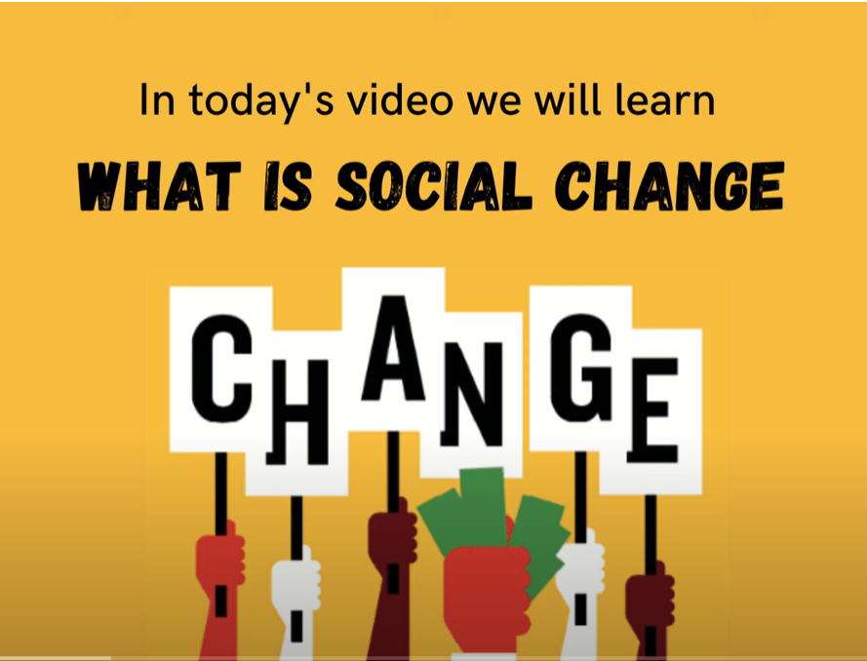
How it looks like?
In this short video, you will learn the definitions and characteristics of Social Change.
Click on the right to watch the video.

Slide 29
Let’s think about how to Interpret Social Change
What is Social Change?
Why should we pay attention to it?
Factors to consider when interpreting social change
How does interpretation help to understand social change?

Slide 30
Tips and Hints
What is social change?
Factors to consider when interpreting social change
How does interpretation help to understand social change?
In sociology, it is the alteration of mechanisms within the social structure, characterised by changes in cultural symbols, rules of behaviour, social organisations, or value systems.
Why we should pay attention to it?
When interpreting social change, it is important to consider factors such as historical context, cultural and social norms, economic and political factors, power dynamics, and diversity and inclusion.
Changes in human interactions and relationships can transform cultural and social institutions, leading to profound and long-term results for society over time.
Interpretation analyses social change's causes, effects, and perspectives of different groups, creating a more comprehensive understanding of its complexities.
Title One
Title Three

Slide 31
CHALLENGE
Understanding Social Change: Interpreting Perspectives.
Objective: To develop critical thinking and interpretive skills to better understand the complexities of social change.

Slide 32
The challenge
Task 1
Let’s dig deeper
Understanding Social Change: Interpreting Perspectives.
Research a social change issue and create a visual representation that highlights the issue's complexities such as maps, diagrams etc.
Remember, this is just an exercise and you do not have to spend days working on this. The goal here is that you get the feeling of what design thinking is and how you can use it to create a better community for you and your neighbors, friends, colleagues, and peers.
Task 2
Task 3
Analyse a social change issue from multiple perspectives, including those that challenge your assumptions.
Research a social change issue from the perspective of a specific group affected by the issue.
Task 4
Task 5
Create a plan to communicate a social change issue using different mediums to engage a diverse audience. social media, video etc.
Develop a plan of action to address a social change issue and present proposal to local community group.

Slide 33



Here are some resources you can use
Read this
Have a look at
Finding voice: A visual arts approach to engaging social change in particular the section ‘Mapping your Journey’
The SDGs provide a framework for understanding and addressing global social change issues, such as poverty, inequality, and climate change.
Watch this
Watch the Tate’s short video on the Art of Social Change
Analyse this
Article on 'Perspectives on interpreting' talks about interpreting in everyday life as well as in your community
Listen to this
Podcast of professor Jane Gray on researching Social Change

Slide 34
It is time to write down what did you learn?
In one sentence please summarise what did you learn?
______________________________________________________________________________________________________________________________________
Do you now know what will solve your challenge, and what needs to happen?
______________________________________________________________________________________________________________________________________

Slide 35
Now that you know what to do, let’s plan how to do it. Time to ACT!
On the next slide, there is space for you to get all your thoughts down on paper.
Think of a challenge or challenges within your community, write it in the middle circle and work out how to solve it using design thinking.
STEP 3: _________________________________________________________________________
STEP 2: _________________________________________________________________________
Title One
Title Two
Title Three
Title Four

Slide 36
Define
Act
Challenge
Test
Result

Slide 37
Congratulations!
You have completed Module 4

